Slide 1
The Rise of the
Citizen Storyteller:
How to Build an Organizational culture
that encourages and engages
your natural storytellers

Slide 2
Who Are We?
Professor John D. Trybus, APR
Managing Director
jt452@georgetown.edu
Kathy Swayze, CFRE
President &
Creative Director
kswayze@impactdc.com
@JohnDTrybus
@impactDC
Notes:
Kathy & John talk about how you got into storytelling…

Slide 3
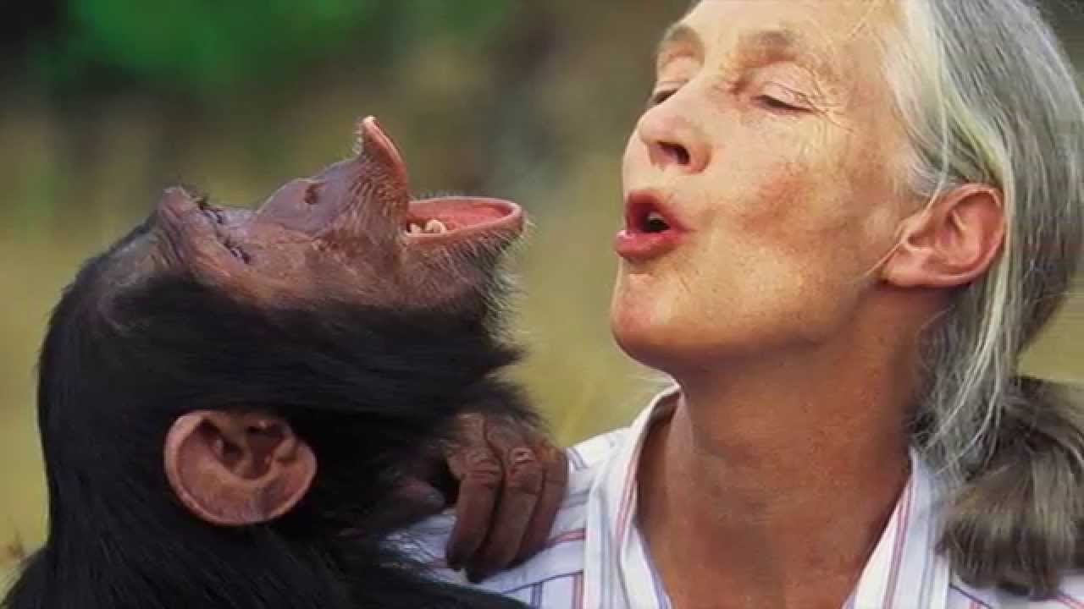
What Do We Mean by Citizen Storytelling?
Notes:
JOHN

Slide 4
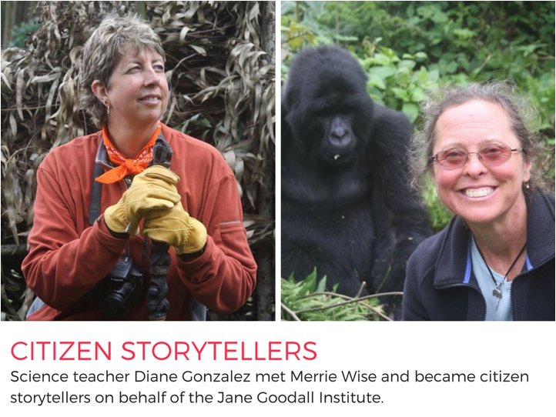
Notes:
JOHN

Slide 5
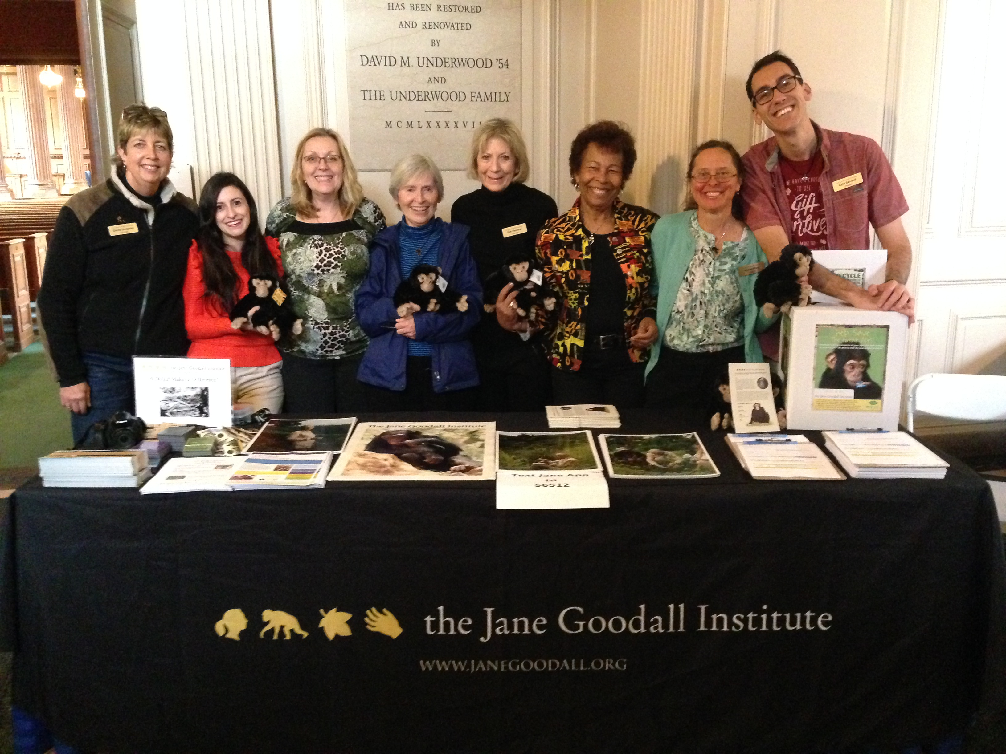

Slide 6
The Gombette Stalkers have told 75K+ stories
Notes:
JOHN

Slide 7
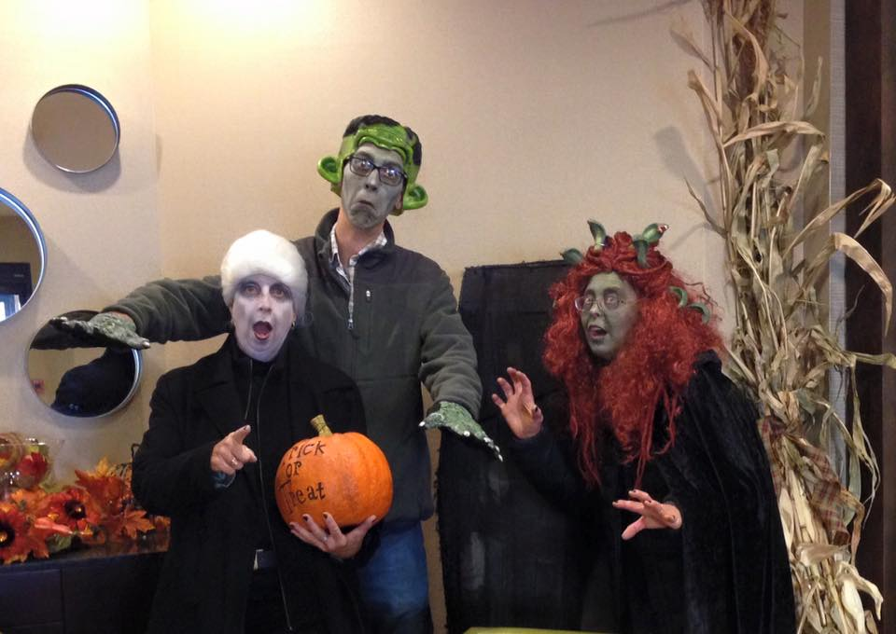

Slide 8
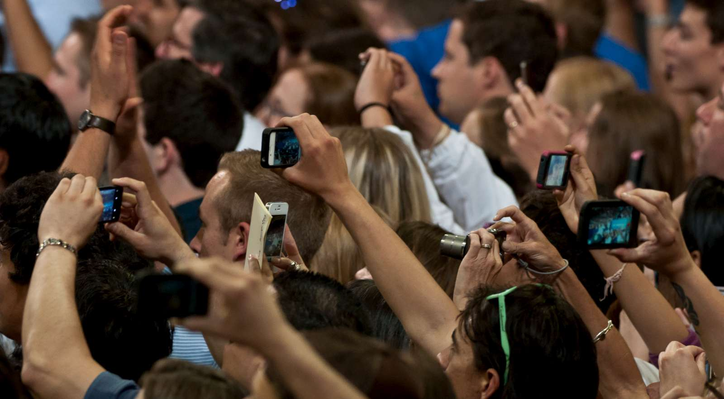
Looking Ahead: The Prediction
In the future, social impact organizations will realize that their supporters also can provide valuable non-monetary support, and also focus on activating their currency of influence. Citizen Storyteller programs will be created that are duly strategic for the organization while also producing authentic stories.
Notes:
JOHN

Slide 9
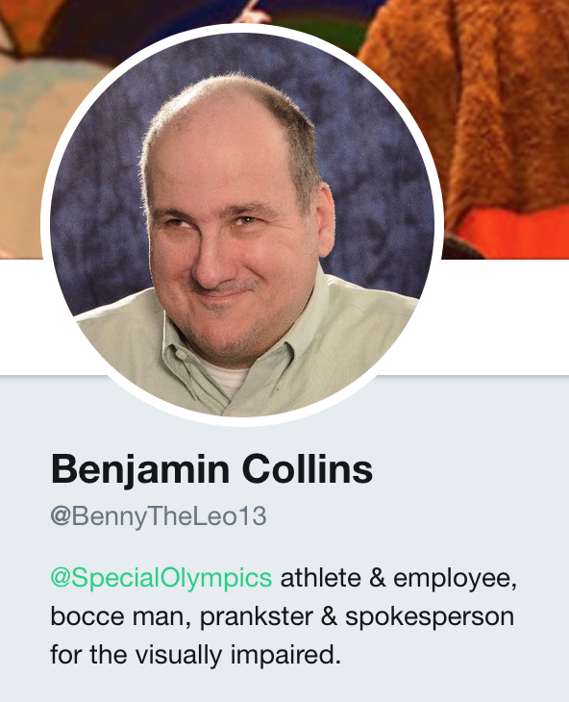
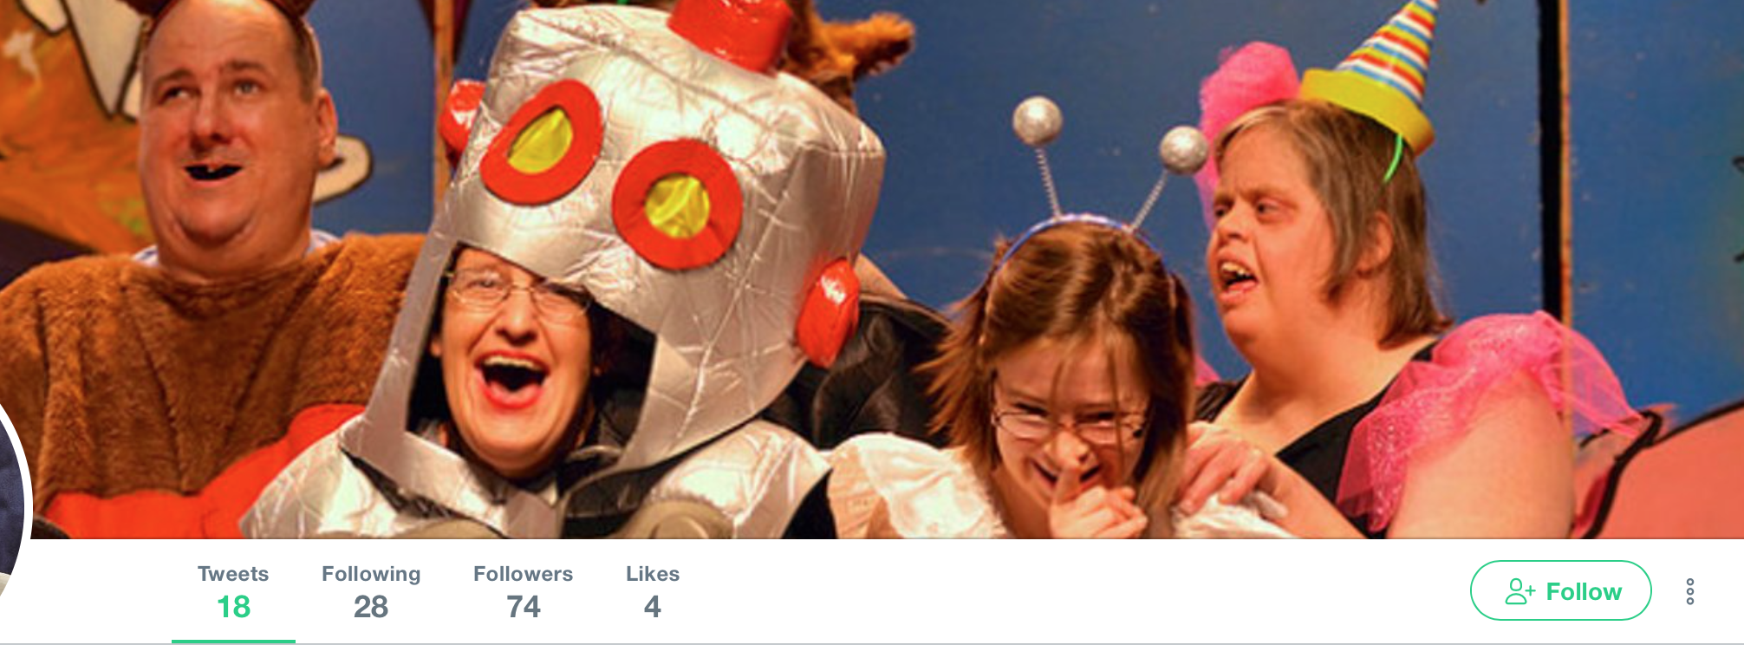
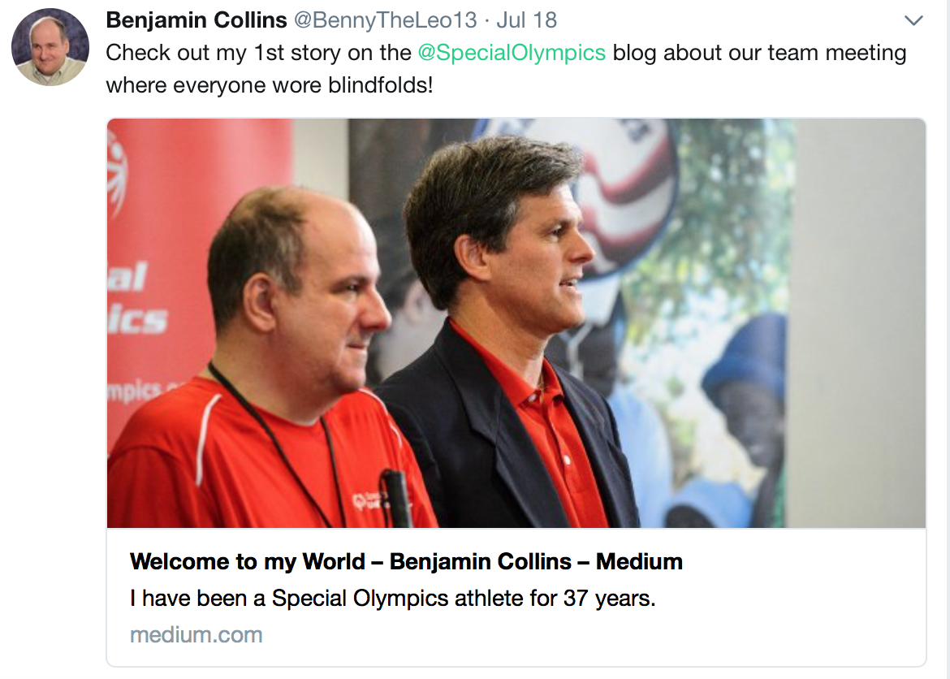
Citizen Storytellers are everywhere....it's about
finding and activating them!

Slide 10
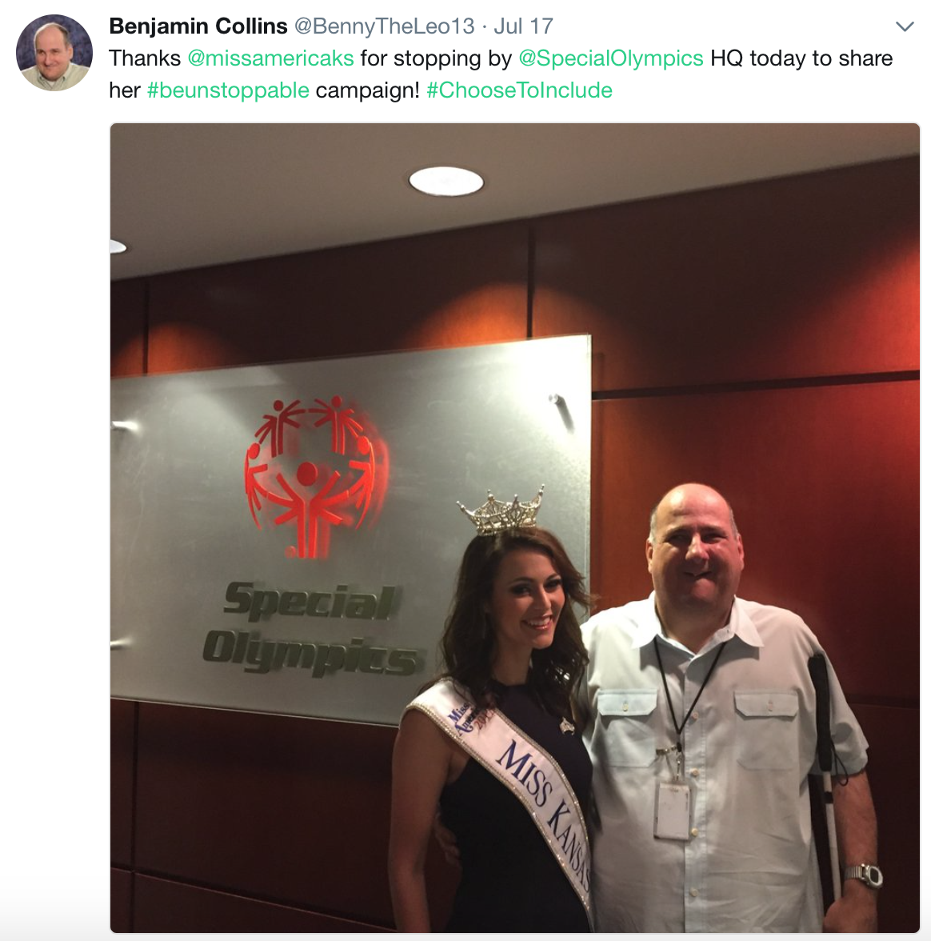
Citizen Storytellers are everywhere....it's about
finding and activating them!
Notes:
https://www.youtube.com/watch?v=EBswOtX1LEI

Slide 11
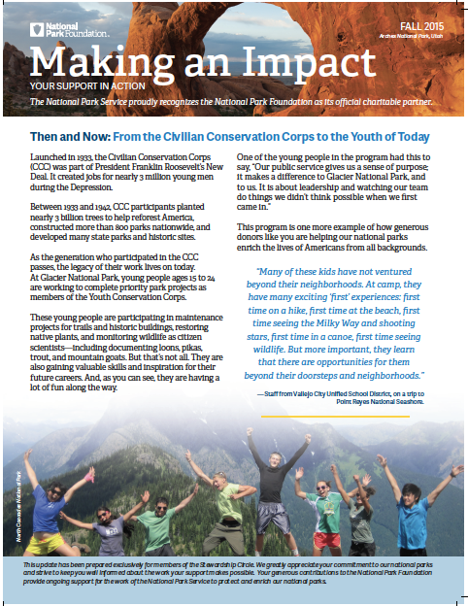
Notes:
KATHY
Leads into next slide about donor story and facilitating the process

Slide 12
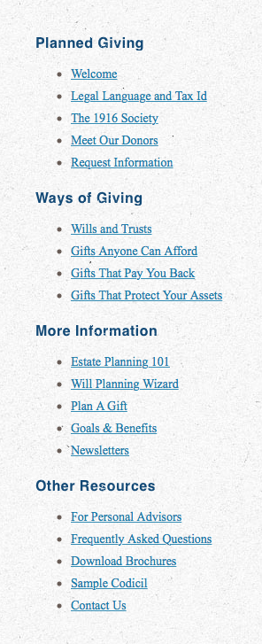
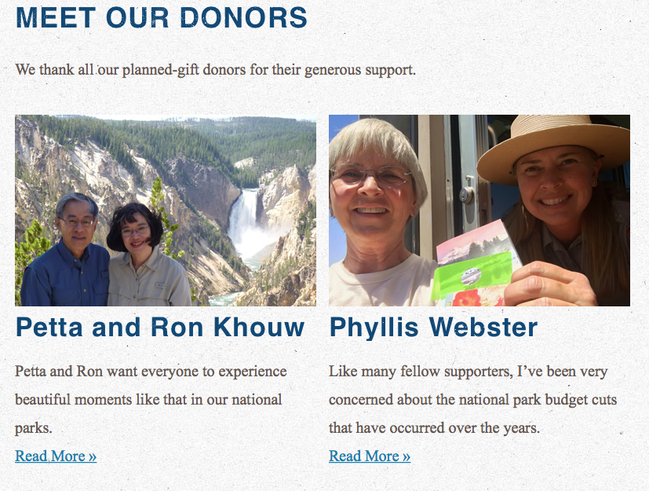
Notes:
KATHY
Only feature TWO stories
Insert hyperlink on page
Even when you coordinate it, people can say nicer things about you than you can say about yourself and write them in first person--

Slide 13
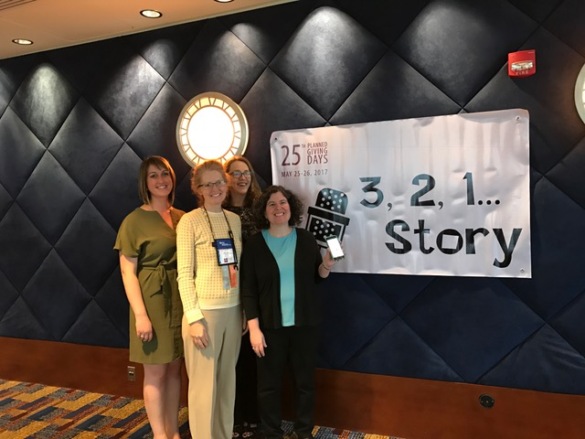
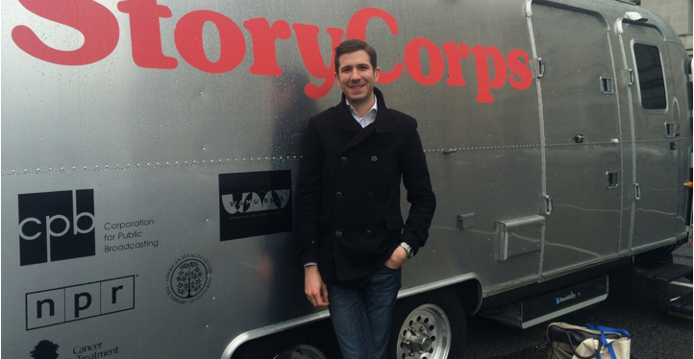
StoryCorps in Action
Notes:
KATHY
Story Corps in action
Kathy share PG Days example

Slide 14
Everyone
Is
Doing It!
Notes:
KATHY
All joking aside, Many prominent organizations are incorporating Citizen Storytelling into their organizations in different ways.

Slide 15
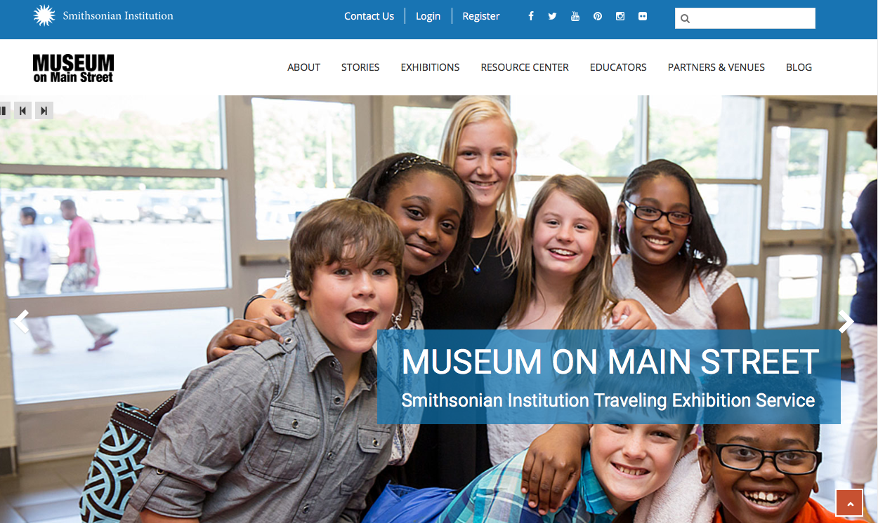
Notes:
KATHY
museum on main st. is part of the Smithsonian Institution Traveling Exihbition. It allows access to Smithsonian to small town America through exhibitions, research, educational resources and programming. They’ve visited 1,400 communities since 1994
In 2011, we began collecting stories about life in small-town America. We’ve gathered more than 1,200 stories from people like you. Share you story!

Slide 16
The Nature Conservancy
Notes:
KATHY
advocacy example

Slide 17
Pantsuit Nation:
Inspired by Clinton’s campaign
Harness power of collective storytelling
Bring Minority Voices Forward
Notes:
JOHN
PSN

Slide 18
Pantsuit Nation:
Nikkya Hargrove
#pantsuitnation #StoriesSparkChange
"In a little over two weeks, I will remember my mother who passed away when I was 25 years old. Since then, I've accomplished so much in the almost 10 years since her passing: adopted my half-brother, married my partner, bought a house, gave birth to healthy twin daughters, became a freelance writer...so much I am proud of. As of late, one of the greatest lessons she ever taught me plays over in my mind: believe in myself and my strengths.
Notes:
KATHY

Slide 19
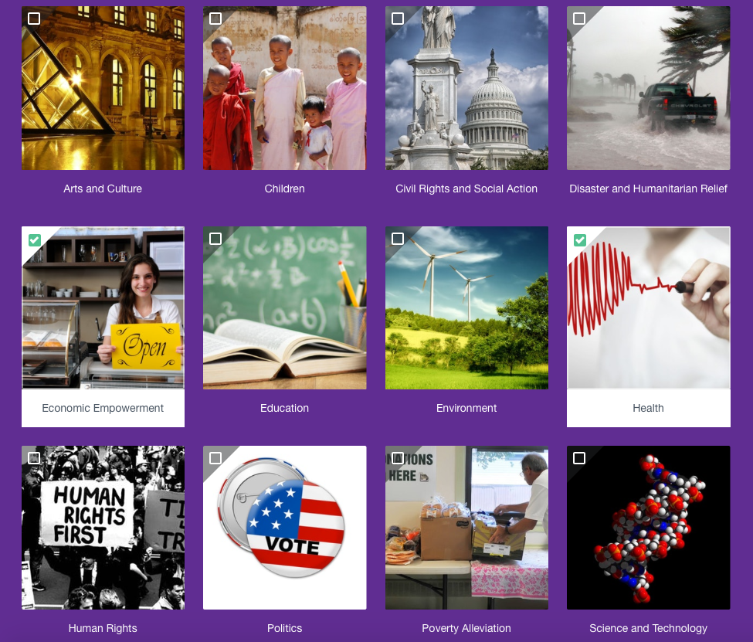
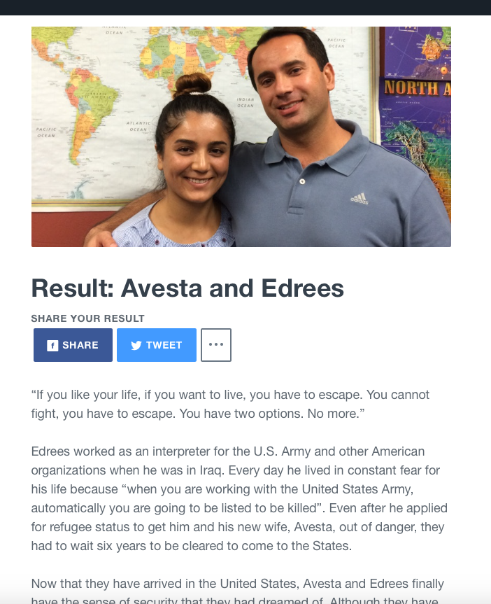
Notes:
https://www.qzzr.com/c/quiz/234847/story-sifter-get-to-know-our-new-americans
JOHN
Catholic Charities Example

Slide 20
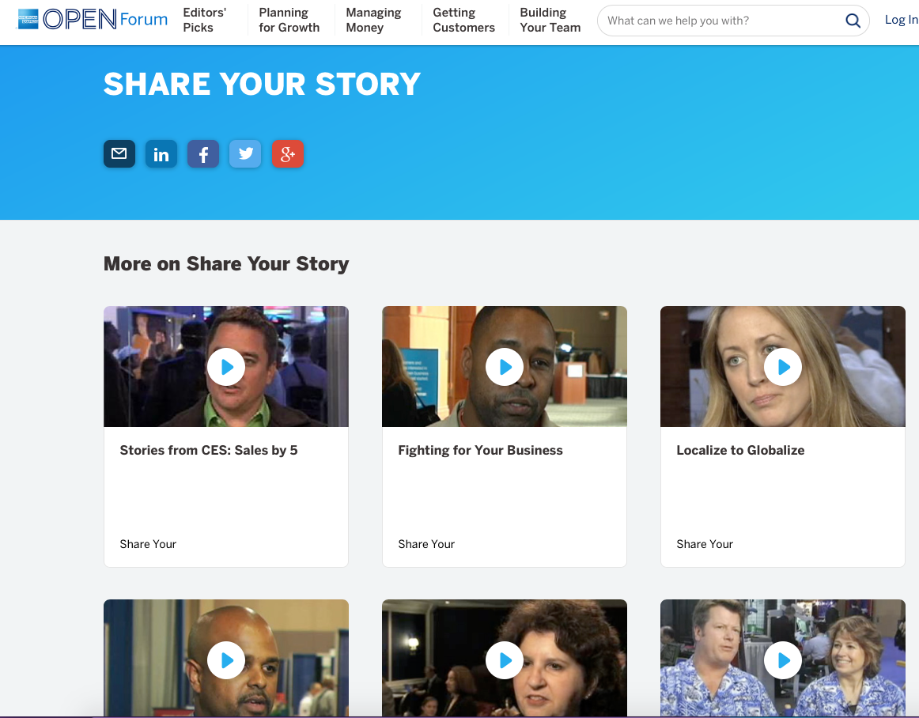
Don't be the only one who goes around telling the story of your company (or non-profit)
Storytelling is the antidote to complacency, so get people excited about telling your company story
Source: 11 Powerful Ways to Tell Your Story, Bruna Martinuzzi
Notes:
KATHY
corporate sector
Evangelize Your Storytelling
There's a native American saying that goes like this: "It takes a thousand voices to tell a single story." Similarly, it takes all the voices in your organization to tell your story.
ASK THE AUDIENCE FOR THEIR EXPERIENCES

Slide 21
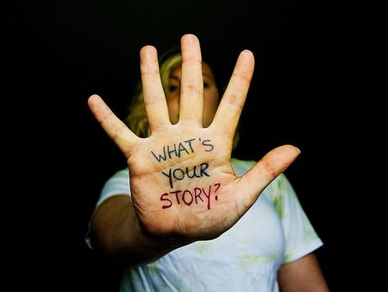
Why Do Citizen Storytelling?
Stories are Inextricably Linked to What it Means to be Human
Stories Create Emotion + Drive Action
Citizen Storytellers Extend the Currency of Influence
Drive Authenticity in Ways You Can't
Notes:
JOHN
Stories were the number one motivator of the more than 50% of respondents who mad ether leap from supporting a cause online to also supporting offline.
Source: Georgetown CSIC, Digital Persuasion report
John: overview of power of story—- creating emotion and driving action. Added benefit of authentic
ADD RESEARCH POINT ON IMPORTANCE AND mettle man trust in the era of fake news, how do you build trust— esp. for millennials
… so then why isn’t everyone doing them? It takes investment to do it right!

Slide 22
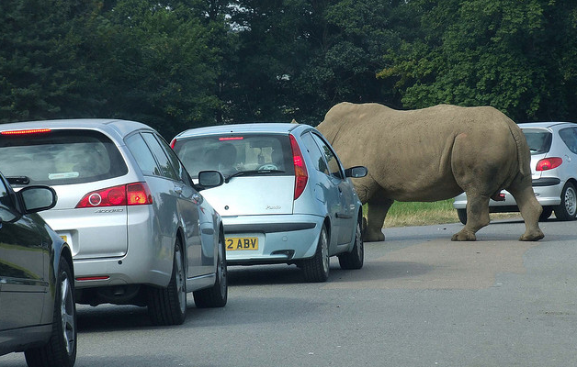
Road Blocks
Content vs. Stories
Lack of Financial Resources
Lack of Staff Time
Apathy

Slide 23
Content
vs. Story
Of the 355 social impact “stories” analyzed, only slightly more than half (54%) were actual stories, based on the five building black framework. Most pieces of content are mistakenly branded as a “story.”

Slide 24
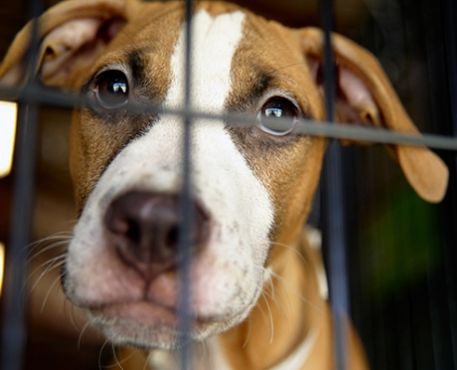
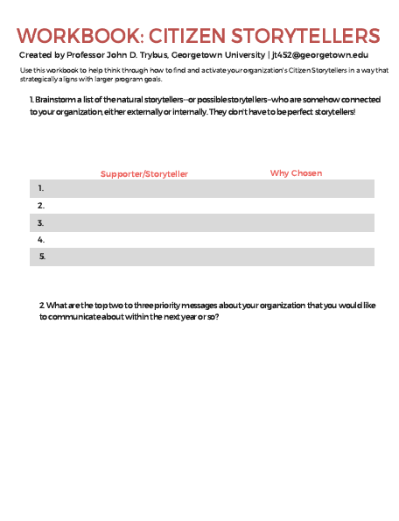
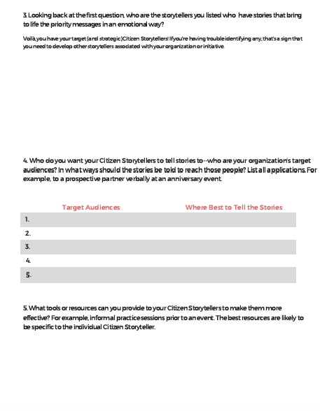
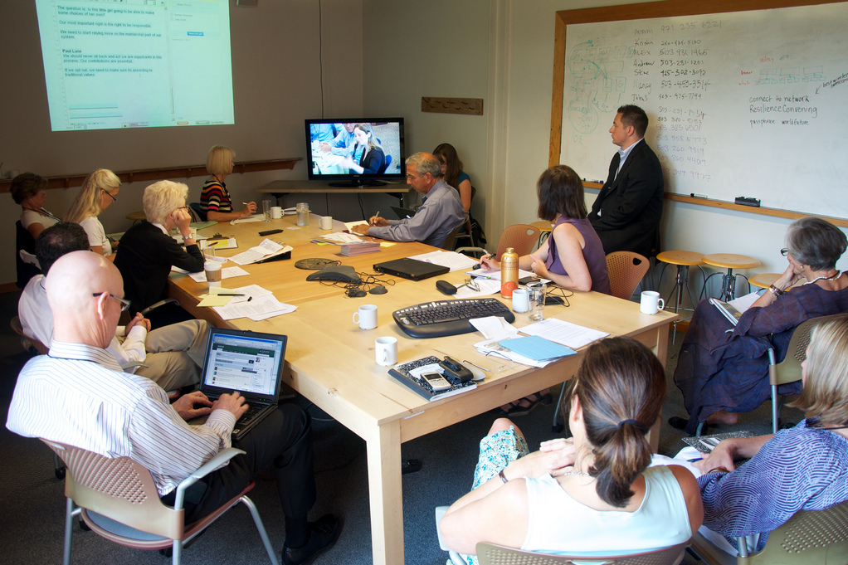
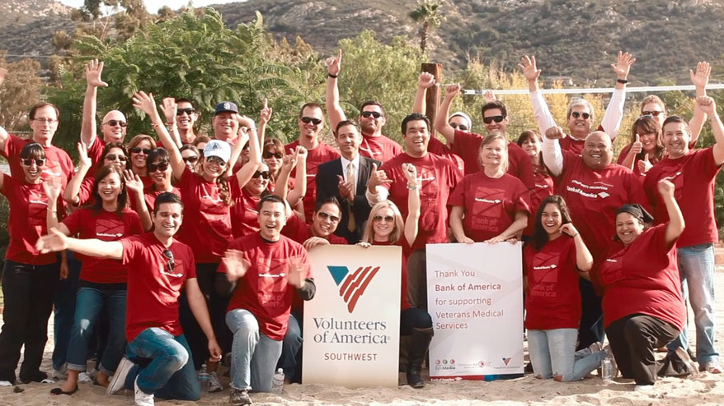
Handout: Citizen Stoytelling Workbook
Notes:
JOHN
Explain what the workbook is for. Ask audience to fill out first 3 questions and let them know we’ll group to discuss in 5 or 7 minutes

Slide 25
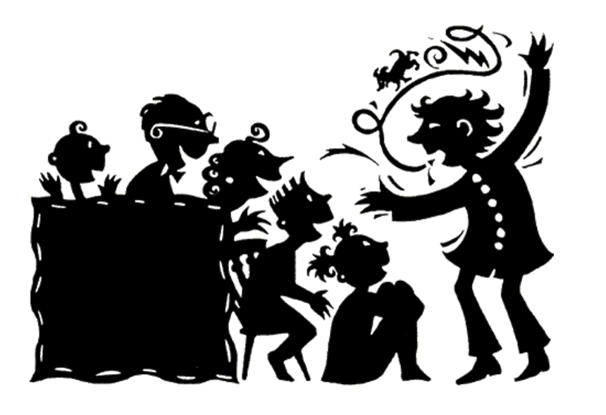
Does your org have a storytelling culture?
Storytelling Culture
Self-Assessment Tool
Notes:
It’s not just their job, but eveyone’s job and they need to think about insfusing this in the whole org. not just development or comms.

Slide 26
Jump Start: Building Your Storytelling Culture
Storytelling time at staff and board meetings
Find and nurture your storytelling ambassadors
Set expectations with leadership
Get away from your desk

Slide 27
Questions?
Notes:
Insert photo

Slide 28
Thank You!
Contact us at…
jt452@georgetown.edu
kswayze@impactdc.com
Don’t forget to visit the
Solutions Showcase!
Many of the ideas discussed today are on display at the Solutions Showcase!

