Slide 1

Court, Date and Propose:
Building Relationships with your Mid-Level Donors
Lori Held, Trout Unlimited
Julie Price, Impact Communications
Kathy Swayze, CFRE, Impact Communications
Notes:
Introduce yourself and your organization

Slide 2


How do you define mid-level?
Major
Gifts
$$$$$
Direct Response
One to One
?
One to Many
Notes:
Julie
Ask audience how their organization defines mid-level
Ask them to raise hands if work in direct response, major gifts, grants?, communications?
Do you have a mid-level program established or do you need to start one? With benefits! Feel like part of a community
Possibly give shout outs to other programs we’ve worked on, and lessons learned:
MPR- not maxing potential of members
AARP – branding front- started from scratch?
NatGeo maybe examples? Had program set up but needed audit

Slide 3
“When Harvard did a study after their last campaign, of their 254 million-dollar donors, 2 out of 3 started with first-time gifts of $100 or less.”
-- Jerry Panas, 2017
Notes:
Julie
So, what’s the big deal? Entry-level gifts indicate interest, not capacity – we will show you REAL examples of this in the presentation
Potential Major Donors!
Strong Source of Revenue in Their Own Right! 3/4 of their high-end donors started with a gift of $100- justification
From Lori: I know Kathy mentioned showing how many mid-level and major donors come in via direct mail. I’m not sure I have that, but the first bar chart in the attached is interesting and shows essentially the same fact, namely that $1,000+ folks start out low. I tallied the lower levels and, of our $1,000+ donors, fully 63.6% joined at less than $50. And 73.5% joined at less than $100.

Slide 4

Percentage of High End Donors who made their original gift at less than $100
Donors who made original gift at $100 or more
Giving Level | Percentage of High End Donors by Origin Amount
$1,000+ | 15.0%
$500 - 999 | 3.2%
$250 - 499 | 2.3%
$100 - 249 | 6.0%
$75 - 99 | 1.3%
$50 - 74 | 8.6%
$35 - 49 | 11.9%
$25 - 34 | 35.4%
$10 - 24 | 16.1%
Less than $10 | 0.2%
Donors who made original gift at less than $100
Notes:
This table is capped at $9,999, so this doesn’t look at the tippy top donors
Table has incremental breakdown. Pie chart groups $0 to 99 donors and $100plus donors.

Slide 5
Why is this a Challenge?
Mid-Level donors are in an “in between” space where budget dollars have not been allocated.
Success means borrowing from major gifts and direct strategies—and teams are often too “siloed” for close collaboration.
“Major Gifts in the Mail” is an odd concept
for some.
Case for giving for mid-level donors is different from low dollar donors.
Notes:
Julie:
SOLUTION: Create a program that makes these important supporters feel appreciated

Slide 6
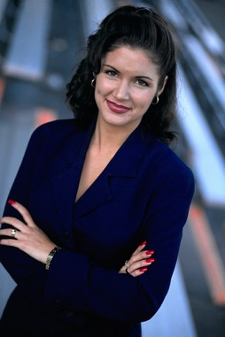

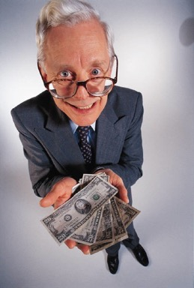


Can we all get along?
Notes:
JULIE:
Lots of different types of people don’t dress the same way or think the same way. It’s important for all team members to cooperate when talking to donors. Let’s talk about why they ought to start talking to each other more to improve communications to donors at every level of the donor pyramid.

Slide 7
A Different Kind of Conversation with Donors
Treat them like family, insiders.
Define the solution in grand terms – not your work plan but how you will change the world.
Position your donor right in the center of the solution.
Give them perks but acknowledge their intensions are bigger than perks.
Share results & share credit.
Notes:
JULIE:
Talking to donors …

Slide 8
What do mid-level donors want?
Recognition and Appreciation
Access to Leaders
Insider Information
Notes:
Julie
These people don’t want tchotckes – Deb Peeples,
***********INTRODUCE LORI*********

Slide 9
About
Trout Unlimited
Formed in 1959
150,000 Angler/Conservationists
Primarily Low Dollar Dues Payers
Strong mission worthy of major gifts
Notes:
LORI:
Hybrid organization…association of fly fishermen and women AND a conservation organization with a strong mission.
Great retention and dues paying but low on philanthropy.
Pipeline was neglected. Major giving and low dollar but very little in between.
Mid-level is now a strong source of revenue.
… $1.3 million in FY16. (low dollar brings in about $6 million)

Slide 10
Why we care about the
mid-level
WHY?
Our goal is to help TU members understand that to be fully successful in our mission we need their strong and generous support on an annual basis. Building a giving club that communicates this need, creates a sense of appreciation & recognition, and offers unique benefits can help!
Notes:
LORI:
Unique challenge. Strong membership culture – not traditional donors (fishing buddies, subscribers, buyers). Needed a case for higher levels of giving internally AND with external audiences. Staff = reluctant fundraisers. A mid-level giving club helped staff feel more comfortable asking.

Slide 11

So where do we start?
Audit
Rebrand of the Giving Clubs
Recommended new position for mid-level donors
Team of MGOs, Membership and Marketing staff to make it work
Notes:
LORI:
So, where did we start?
Major gift staff were managing mid-level mailings as a fringe project, almost as time permitted. Often excluding people from appeals. Fisherman & reluctant fundraisers.
Lori- CFO
Audit – outside experts needed to communicate opportunities
Recommendations included DM management and…see slide.

Slide 12

Notes:
LORI:
New giving club…The Griffith Circle named after George Griffith.
Defined mid-level...
Most TU members give $35 annually.
Premiums used to motivate giving … and yet 40% of $1000+ folks were declining premiums…a sign of philanthropic giving.
Next step… benefits.

Slide 13
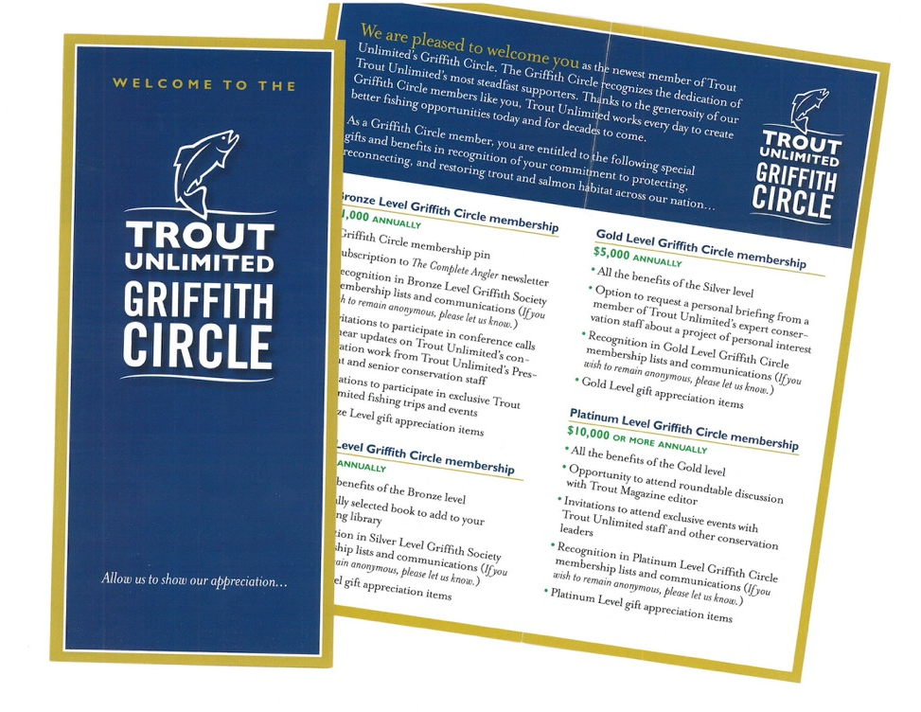
Review your benefits structure
Notes:
LORI:
Audit and subsequent branding suggested building giving levels and benefits (beyond premiums).
We didn’t have staff to do a lot of complicated stuff SO built benefits around access and information. Examples: $5,000 personal briefing with conservation staff. $10,000 roundtable.
And most popular…

Slide 14
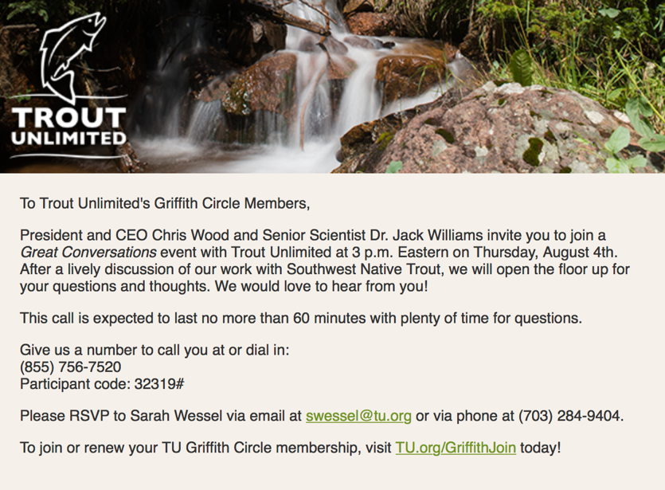
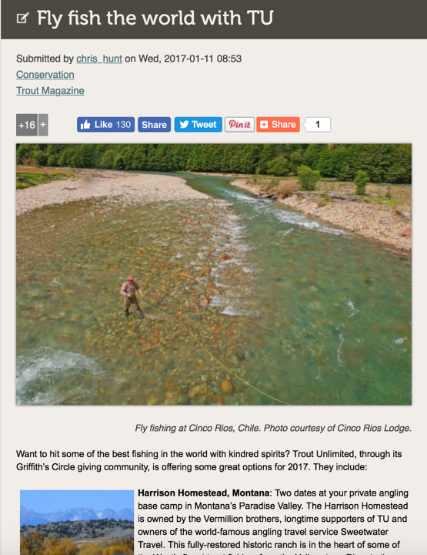
Host tele-townhalls, events and trips
Notes:
LORI:
Tele-townhalls, events and trips. Tele-Townhall post cards and emails, events and fishing trips.
We feel even if people are unable to attend, it gives them a sense of opportunity/exclusivity that they appreciate.

Slide 15
Percentage of Donors by Giving Level and Revenue by Giving Level
Giving Level | Percent of Donors by Giving Level | Percent of Revenue by Giving Level
$1,000-9999 | 1.9% | 34.6%
$100 - 999 | 10.3% | 25.3%
$0 - 99 | 87.7% | 40.0%
Only a few donors give above $1,000, but they provide more than one third of revenue.
Notes:
LORI:
Fewer than two percent of member donors give over 1/3 of revenue. Excludes $10k gifts.
TU members fly fish, which suggests they have money. They’re also passionate about fishing. Often it defines them. Tapping in to that passion is key. Join for the fishing, stay (and upgrade) for the conservation.

Slide 16
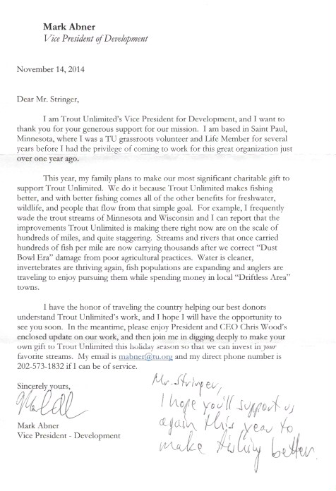
Major Gifts at Year End
Notes:
LORI:
First year working with Impact, VP Dev. wanted to suppress all MGO assigned donors from the year-end appeal. Agreed to prepare a high-quality appeal with an added personal touch… handwritten lift notes.
Rich letter, packed with conservation messaging. Higher asks.
Managed members ended up producing several hundred thousand. Non-managed, mid-level members’ giving doubled.
RESULTS:
Total Revenue 2015: $102,577
Total Revenue 2014: $63,775
Percent Increase: 60.84%
Response Rate 2015: 2.19%
Response Rate 2014: 1.91%
Percent Increase: 14.73%
(Average gift actually declined from $874 to $698, so we probably don’t want to get into that. I wonder if that decrease had to do with the huge increase in the mail quantity, from 3830 in 2014 to 6722 in 2015? I’m wondering if we went further back into the lapsed CCF file or something?

Slide 17
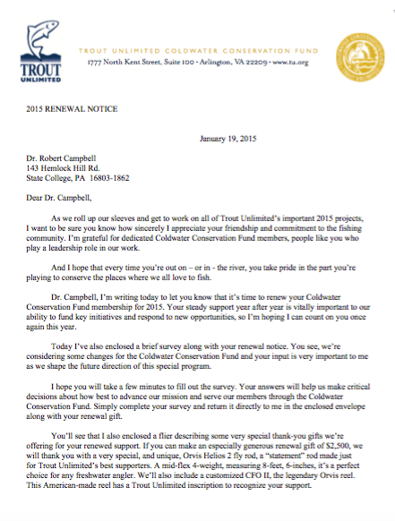
Renewal Handling
Notes:
LORI:
Year-end appeal followed by January renewals. Switched from monthly, expire-based series to 4-month series (Jan-April). Better fit for volume.
Year one – engaged with a survey including questions about rebranding.
Year two – engaged with an irresistable envelope and lapel pin.
(Lori to share how the numbers look verbally. )
2014 vs. 2015
Total Gifts Total Revenue
FY 14 Renewals 162 $225,705
FY 15 Renewals 284 $391,956

Slide 18

Calendar Campaign Summer 2015
Notes:
LORI:
Next up…transforming our formula, low-dollar calendar mailing into a high-quality mid-level mailing.
Nice quality, closed face carrier with first class postage, rich 4-page personalized letter, specially-selected higher end gifts, nice calendar.
Success was not truly appreciated until the following year when…

Slide 19
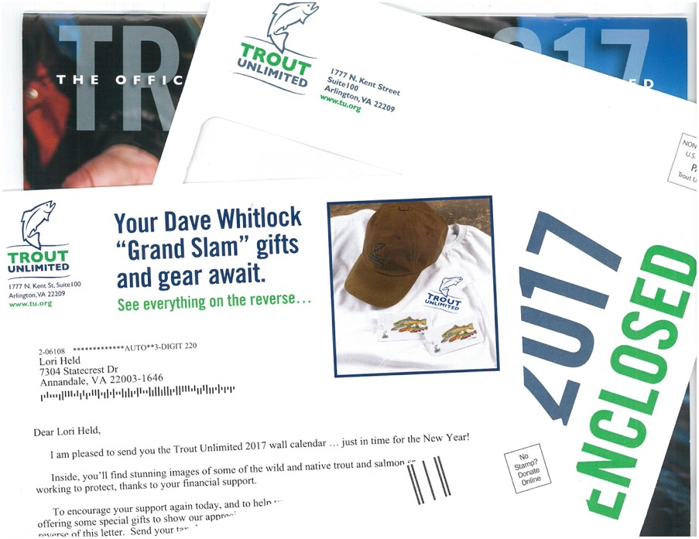
Calendar campaign Summer 2016
Notes:
LORI:
We no longer had Impact at the table and we didn’t think we had the bandwidth to produce another high-quality package SO mid-level members go regular member treatment:
Window envelope
One-page letter
Lower dollar premiums
And the results matched the treatment:

Slide 20
Results of Major Gifts Effort
FY 2015 and FY 2016
 | FY 2015 Closed-face package with rich letter Handwritten notes Premiums at $600, $1000, $1500 and $2500 | FY 2016 Window package with short letter Premiums at $75, $1000 and $2500
Pieces mailed | 2766 | 2709
Total # of Gifts | 66 | 163
Gross Revenue | $62,475 | $37,480
Average Gift | $946.59 | $229.94
Total $1000+ Gifts | $33,000 from (23) $1000+ gifts (included in gross revenue above) | $16,000 from (13) $1000+ gifts (Included in gross revenue above)
Notes:
File counts may be small, but still should learn from it even if it’s not a head-to-head test.
(This is not a true A/B test.)
Downgraded members and produced significantly less revenue.
Lesson learned.

Slide 21
% File Growth in 2 Years
 | Jan 2015 | Jan 2017
Total # Griffith Circle Members | 923 | 1,107
Notes:
LORI:
Success! After two years of work our Griffith Circle membership grew! And the average gift ($1500) did not suffer.
What’s next?

Slide 22
Looking forward…
Staffing
Leadership Changes
Continued Program Growth
Notes:
LORI:
Hoping to get at least a portion of a dedicated staff person’s time in the near future.
New Dev VP committed to growth…and differentiating between mid-level and major giving. Also recommitted to delivering promised benefits.
Anticipating further growth, stability, retention.

Slide 23
Position the Donor in the CENTER of the Solution
Notes:
Kathy
The letter we just saw referenced a conference call – this is the invitation that was sent out to the donors to attend that call.

Slide 24
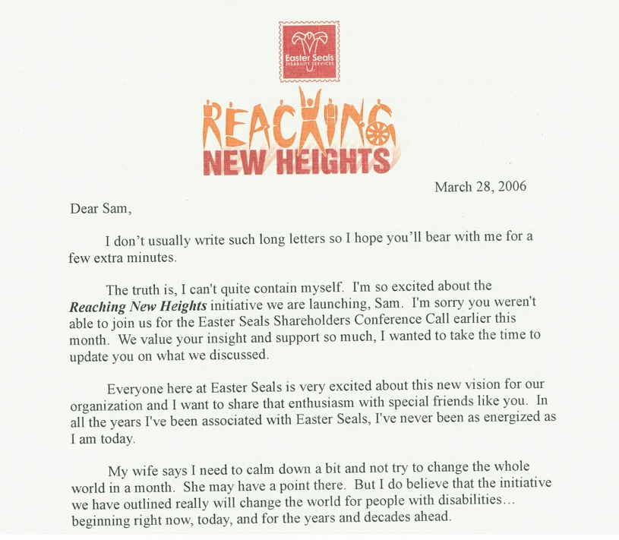
Don’t be afraid to show personality and break the rules.
Notes:
JULIE:
Worked with Phyllis Freedman, Smart Giving. Encompasses a lot of best practices
Ok – here’s the first page of a letter that breaks a lot of the rules you might have in place about communicating with top donors. Second word is a contraction –and two of them in the first sentence. CEO has personality. Don’t be afraid to show personality – this is the Chairman of the Board and if he’s writing to me like an old pal, then I feel important. I’m somebody.
This was an 8 page letter .

Slide 25
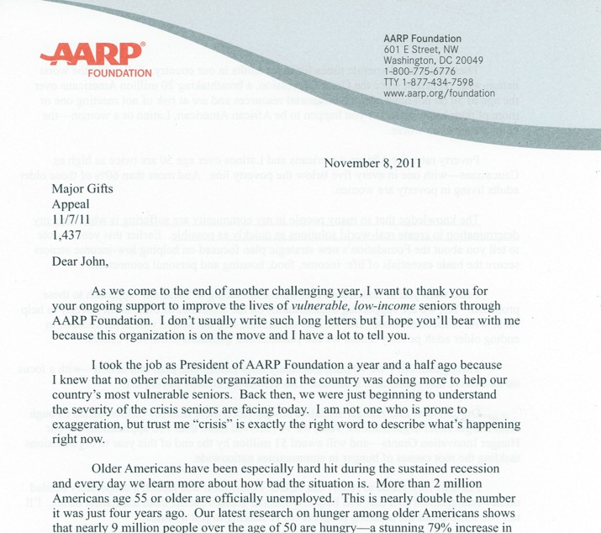
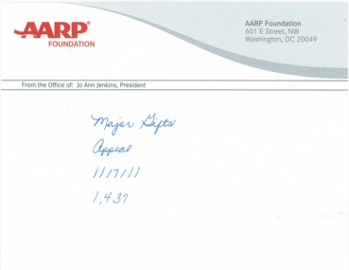
Don’t shy away from long letters
Notes:
Kathy

Slide 26
Mini-Proposals
Notes:
Kathy
Mini-proposals are a great workhorse for higher dollar donors. They combine lots of best practices – makes them feel like an insider, shares lots of information,

Slide 27
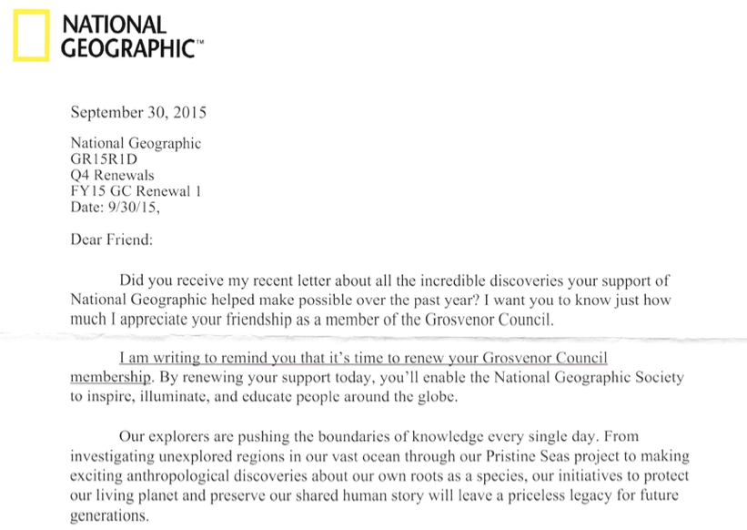
Report back to your donors
Notes:
When an organization decides to make some imporvements and changes, you very rarely choose to change only one thing at a time so it’s truly measurable. This gets at how hard it is to test at these small quantities. Searching for best practices, you can easily apply, not necessarily going to be able to measure results, nor will you be pick it apart. But when the entire ship raises as dramatically as these numbers show, you know you’re doing something right. You can also always backtest, as Lori did with calendar appeal. It’s okay to try multiple things at the same time, you’re looking to make big changes, not just incrementa.
Quantity Total Gifts Average Gift Response Revenue Mailed Rate
2013 renewal mailings (2) 790 66 n/a 8.35% $90,600
2014 renewal mailing 419 44 $1,210 10.26% $53,268
2015 renew al mailings (30 3,059 198 $1,413 6.34% $279,908
As you can see, the first thing to note about the 2015 renewals is that they went to a much larger group than in years past. The rapid growth of the contributing member program and your successful upgrade efforts have resulted in a larger number of donors at the GC level.
Given the rapid change within the file, comparing results year over year is somewhat tricky. However, we note that the overall response rate was down in 2015 compared to previous years. This decline can be attributed to the fact that a large portion of the file is made up of newer donors who are not as loyal as multi-year donors; and that we mailed more notices overall. Response rates generally decline as a renewal series progresses.
A major emphasis in our strategy for 2015 was to try to upgrade donors to a higher level of giving. This effort was successful as evidenced by the 17% increase in average gift from 2014 to 2015.
A major emphasis in our strategy for 2015 was to try to upgrade donors to a higher level of giving. This effort was successful as evidenced by the 17% increase in average gift from 2014 to 2015.

Slide 28
Key Takeaways
Put someone in charge of this group of donors
Build a bridge between major gifts and membership/direct response
Improve quality of solicitations and stewardship touches to this important group
Notes:
Julie
Yesterday is not too soon to pay attention to this vital group.

Slide 29
Contact Us
Lori Held, Trout Unlimited
Email: lheld@tu.org
Julie Price, Impact Communications
Email: jprice@impactdc.com
Kathy Swayze, CFRE, Impact Communications
Email: kswayze@impactdc.com
Notes:
Post names and emails during Q & A.

