Slide 1
Manna From Heaven Isn’t Really From Heaven:
Measuring Success in a Dollars-Now World
Notes:
Meg Opens
Conversation – feel free to ask questions along the way – we love it! If we get to it later, we’ll let you know.

Slide 2
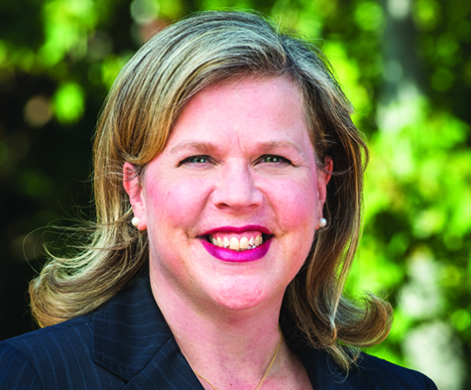
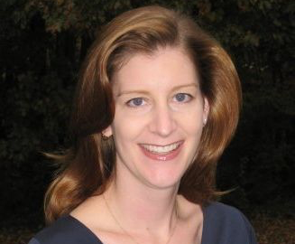
Presenters
Nicole Engdahl
Vice President, Planned and Annual Giving
National Park Foundation
Meg Roberts
Vice President, Gift Planning
Impact Communications
Notes:
MEG begins program

Slide 3
Learning Objectives
Measuring success
How to share results
Make the case for investment
Notes:
Meg
For a lot of leaders of orgs, they don’t get how PG works and think that it is magic that just falls out of the sky like manna from heaven
How do we explain the magic behind the curtain in a way that allows leadership to easily see the value of our programs in comparison to current giving programs?

Slide 4
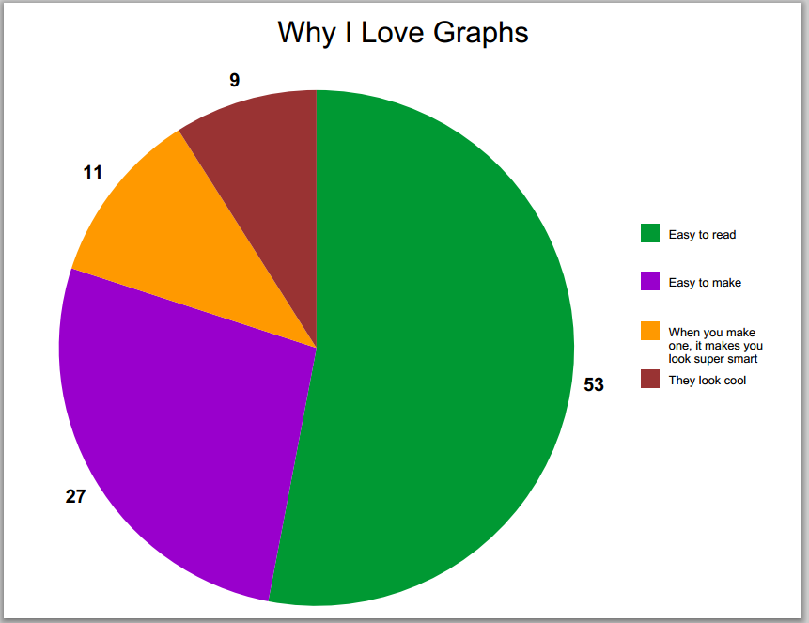
Meaningful Measurements
This Photo by Unknown Author is licensed under CC BY-SA
Notes:
MEG
What I see most often in planned giving programs that are struggling for investment is a lack of appropriate measurements. The planned giving staff knows what to do and why they do it, but they fail to communicate the important and measurable factors to management.
Share example of FFB CFO.
There are many ways to measure success and the most effective planned giving leaders utilize a combination of measurements to prove program effectiveness.

Slide 5
Quick Poll
Notes:
MEG
How many people track your response rates?
How many people show progress between getting a prospect and closing a gift?
How many people calculate and communicate your average gift size to administration at least yearly?

Slide 6
Gift Officer Metrics
Visits | Proposals | Documented Gifts
120 | 25 | $1,750,000
Lead Conversion | Documented Gift Amount
38% | $750,000
Notes:
MEG
Many of us try to compare our work to our major gifts colleagues. But that is only part of the story. And it is often a part of the story that is easiest to ignore or devalue against the ”dollars-now” mentality of most organizations.

Slide 7
Total Sent | 234,767
Left Gift | 58
Intending | 36
Considering | 421
Requested Information | 222
Total Leads | 694
Lead Response Rate | .3%
Potential Pipeline | $15,928,000
FY 2018 Planned Giving Results
Notes:
MEG – MEG ARE THESE NUMBERS FROM A SPECIFIC ORG? I ASK BECAUSE I WANT TO USE NPF NUMBERS LATER – Yes, this is from the Alzheimer’s Association – they have a very bad lead response rate, but it still comes out looking good because of their volume.
We also need to take a note from our direct marketing colleagues – looking at response rates to each marketing effort and then equating it to potential dollar amounts.
Potential income is the number of gifts multiplied by the average gift size ($1,056,000), 50% of intends ($88,000) and 25% considering ($396,000) multiplied by the average gift size ($88,000).

Slide 8
FY 2018 Fall Appeal Results
Campaign Total
Total Solicited
Direct Mail Revenue | $28,364.37
Digital Revenue | $10,510.00
Total Revenue | $38,874.37
# of Direct Mail Donors | 144
# of Digital Donors | 41
Total # of Donors | 185
Direct Mail Avg Gift | $196.97
Digital Avg Gift | $256.34
Total Avg Gift | $210.13
Notes:
MEG
Now, compare that report against this. This sample report is for a direct mail appeal. See how specific is gets? It shows total revenue with a breakdown of channels, the number of donors and the average gift, again by channel. And some reports also show the cost for the mailing and the income against that cost.
Our annual fund colleagues overwhelm leadership with data like that. What do we provide?

Slide 9
Advocating For Your Program
Notes:
NICOLE
In order for you to advocate for your program you have to KNOW your program… Start tracking key performance indicators (KPIs)

Slide 10
Know YOUR Program
Questions | NPF
Formal Age of Program? | 5 years
Over past 5 years… Total $ Value New Gift Int | $41.5 mil
Av # New Gifts Per Yr | 42
Av $ Value New Int Per Yr | $8.3 mil
Av Growth / 5 Yrs | 243%
Total # Legacy Membership | 311
Total # Active Donor File | 200k
# PG Staff | 2
Notes:
NICOLE
Keep track of important pieces of data (KPIs) to know how you are tracking. My program is very young, so I don’t have years of history to track. That means I had to start from scratch. When I started I did a deep dive into our database to pull out as many numbers as I could, going back as far as I could, so now I have almost five years of year-over-year numbers.
The better your data the more you will be able to benchmark and prove your growth. If you are only showing realized gifts, it looks like no movement is happening. Show them the movement every chance you get.

Slide 11
Benchmarks—How Do You Compare?
 | NPF | ORG 1 | ORG 2
Formal Age of Program | 5 | 12 | 24
Over past 5 years… Total $ Value New Int | $41.5 | $13.4 mil | $171.4 mil
Av # New Int Per Yr | 42 | 45 | 571
Av $ Value New Int Per Yr | $8.3 mil | $2.68 mil | $34.28 mil
Av Growth / 5 Yrs | 243% | 153% | 56%
Total Legacy Membership | 311 | 372 | 8,000
Total Active Donor File | 200k | 100k | 1 mil
# PG Staff | 1.5 | 1 | 8
Notes:
NICOLE
Once you have a few years of reliable data (in our case 5 years was my benchmark) then you can make realistic comparisons of your program to other programs. This is how my org compares with several other orgs.
In our case –
Org 1 is comparable.
Org 2 is aspirational.
This allows leadership to see how well our program is doing in the grand scheme of things, and also where we want to go. Always be looking for ways your leadership can BRAG about what you are doing.

Slide 12
Historical PG Stats for NPF
Notes:
Show progress!! My organization went through a major overhaul about 5 years ago, so finding a timeframe was easy. Think about what makes sense for your org – show every ten years?
Charts like this one also demonstrate the difference between a passive PG program and what a focused/formalized program looks like.
We started our formalized program about 5 years ago, and this is a great way to show how that is paying off.
So much of what we do is so slow over

Slide 13
Show What the Future Holds
Notes:
NICOLE
Similar to the earlier chart, you can create ways to show how the work you are doing now, will pay off for the organization farther down the road.
You cannot just assume leadership understands that. Show them
Create regular charts and reports to demonstrate movement.

Slide 14
Record Key Data Points

Slide 15
NPF Planned Giving Pipeline
Current Legacy Society Members | ~Value of KNOWN Gift Intentions | UNKNOWN Legacy Soc Members (1:3 ratio) | ~Value of UNKNOWN Gift Intent (Av. $40k) | Total In PG Pipeline
311 | $50.4 mil | 933 | $37.3 mil | $87.7 mil
Notes:
Showing the potential of your program in current dollars speaks to administration in ways nothing else does.
Similar to Meg’s slide on PG results… you can take some of those numbers and multiply them out to show your pipeline of future gifts. I use even more conservative numbers when I talk about my program to NPF leadership.
NICOLE
Back to this pipeline example: National average (SHARPE) is that for every 1 gift you know of, there are at least 3 people who have included your org in their estate plans and not let you know. John Jensen (SHARPE) often says that the real number is more like 1:10, but we still use a 1:3 known to unknown ratio in order to be nice and conservative when reporting to our board. Here is how we put it together when I talk to leadership about what the PG pipeline looks like RIGHT NOW.
We also use a placeholder of $40,001 for unknown amounts. Sharpe says national average is $45k and we know our average is $68k. Again, if you aren’t sure what numbers to use, go conservative.

Slide 16
Expected Maturity Year
Notes:
NICOLE
Then, take both pieces of data – the known legacy society members – and the unknown pipeline – and put them together to show the future

Slide 17
Storytelling & Making the Case
Notes:
MEG introduce topic
Shared both externally and internally
It can’t be just reports internally – they need something memorable
Create reports that tell a story so you can also be constantly teaching UP and OUT

Slide 18
Sample PG KPI Sheet
Planned Giving
Snapshot – FY19 Q2
 | FY19 Budget Goals | FY19 Budget YTD | FY19 Actuals YTD | % to Budget FY19 | % to Budget YTD | Variance YTD
New Leg Soc Members | 50 | 25 | 28 | 56% | 112% | +3
Realized Beq & New CGAs | $7,000,000 | $3,500,000 | $4,167,000 | 60% | 119% | +$667,000
New Intentions | $1,250,000 | $620,000 | $868,555 | 70% | 140% | +$248,555
Current Legacy Society Members | ~Value of KNOWN Gift Intentions | UNKNOWN Legacy Soc Members (1:3 ratio) | ~Value of UNKNOWN Gift Intent (Av. $40k) | Total In PG Pipeline
311 | $50.4 mil | 933 | $37.3 mil | $87.7 mil
Notes:
MEG – way too many numbers for some of them – but create as needed – show stories
will tell story of COO whom she is training. My COO loves numbers!! Also, he remembers them.
So, I created a KPI sheet for him to take with him to board meetings.
I highlight the most important numbers, and then sprinkle in some actual stories (which we will get to in a minute)
Now President is saying her words back out
(We have to do this with agencies and vendors, too)

Slide 19
Correlation Between MG & PG
 | # of Current Legacy Society (Beq only) | Total $ Amount of Outright Gifts | Total $ Amount Planned Gifts
Outright gifts of $1 million+ | 4 | $8.9 mil | $5.2 mil
$100k-$999k | 9 | $3.5 mil | $7.6 mil*
$10k-$99k | 18 | $518 k | $2.9 mil
< $10k | 267** | $269 k | $36.3 mil
* There is one PG for $5 mil in this section.
** Of these people, 8 have made PG of $1 million+ to NPF. Their total lifetime giving is $12,225… combined.
Notes:
NICOLE
AND, as if that isn’t enough, we need to show that we know our constituency. This is Nicole’s chart showing the make up of her legacy society.
NICOLE: There is a common myth that people who make million dollar outright gifts are your best prospects for planned gifts. This simply is not true. Your best prospect for a future planned gift is usually your most loyal donor, who often makes smaller, consistent and frequent gifts. To prove this point I pulled data from my own legacy society.
We have 4 donors who have made million dollar outright gifts and have also left us in their estate plans, However – we have 267 people who have made outright gifts of less than $10k (lifetime) and yet they have left us the largest percentage of our future gifts. I need to be focused on cultivating and stewarding this bottom of the pyramid group.
MEG: SIDE BENEFIT: allows you to talk from a stance of knowledge of your program instead of one of protectiveness

Slide 20
MG/PG Correlation
Gift Value (millions)
<$10k
$10k-$99k
$100k-$999k
$1 mil
Legacy Society Members
Notes:
NICOLE
Sometimes you have to show the same pieces of information different ways –
If the story you are telling doesn’t seem to be resonating, tell it a different way.
Here I wanted to show the correlation between outright gifts and planned gifts.
Same data as the last slide, but shown a different way

Slide 21
This is our donor
with the largest
planned gift.
(Millionaire next door)
Notes:
MEG:
Real donor stories
Finding new a different ways to explain your work until it sinks in – finding the ways to visualize the results
Chart to show low effort/high closure and high effort/low closure
Staff time and expense vs. closed gifts

Slide 22
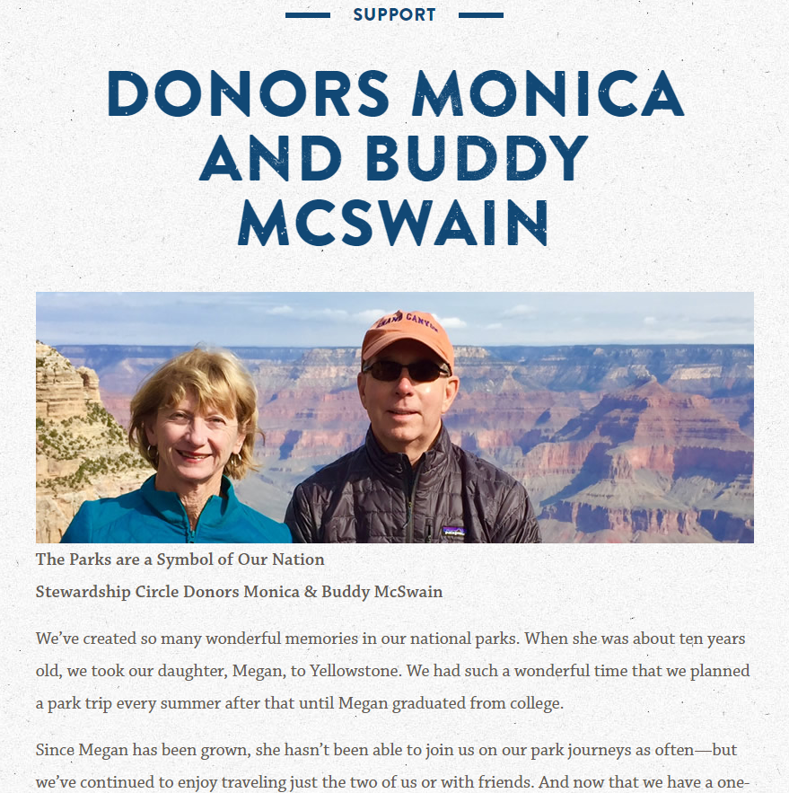
Notes:
Share real donor stories –from the website
Tell stories of the “average” donors, not the extraordinary donors

Slide 23
Questions?
Notes:
MEG close and ask for questions for both to field

Slide 24
Thank you!
Please feel free to keep in touch!
Nicole Engdahl: nengdahl@nationalparks.org
Meg Roberts: mroberts@impactdc.com
Notes:
Nicole is growing her team, so if you are interested in a job change, please see her

