Slide 1

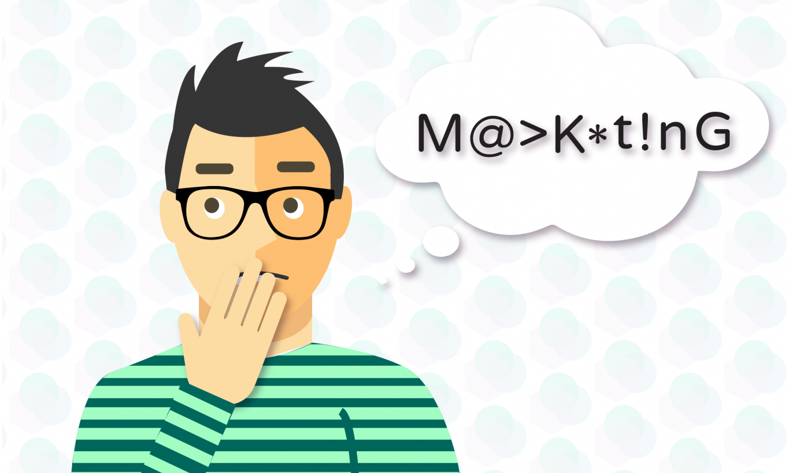
Marketing is not a dirty word
Using direct marketing to close more planned gifts

Slide 2

How many of you in the audience have “Marketing” in your Job description?
Some non-profit leaders turn up their nose to the word “marketing”
Effective direct marketing is essential for every planned giving program
Notes:
KATHY
Questions to get to know you a little
Marketing in your job description? Experience with direct mail for planned giving? Email for planned giving?

Slide 3
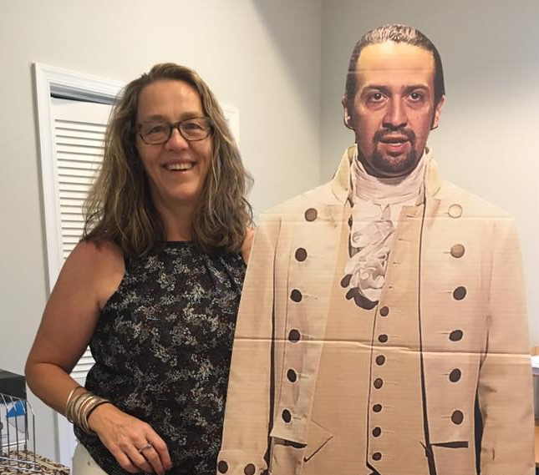
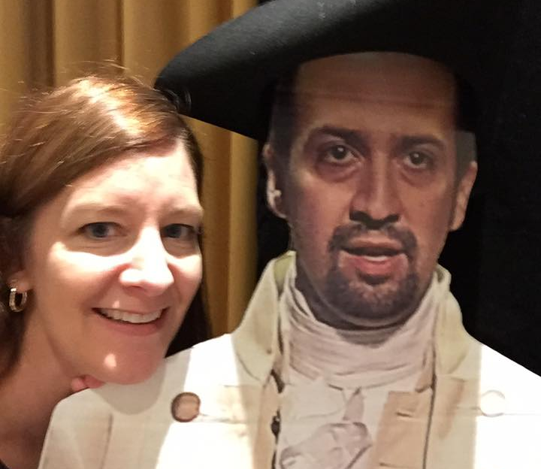

Kathy Swayze, CFRE
President
Meg Roberts, CFRE
Vice President, Planned Giving
Lin-Manuel
Miranda
Notes:
Introductions. Why are we qualified to speak on this topic?

Slide 4
The ten marketing techniques
Every planned giving program should be Using
Notes:
KATHY–we want to jump right in and assume that everyone is here because they need to do more and better marketing. We don’t need to spend time convincing you because you are here. So Meg and I decided to frame this presentations on 10 pointers – techniques that are working well for the clients we work with at Impact. Our goal is to give you 10 ideas that you can take right back and put to work. So let’s get started. Meg is going to start with the first technique.

Slide 5
1. Include your planned giving message on everything!
Repetition is critically important
Make use of marketing materials your organization is already putting out
Donors make decisions on their time, so you must keep your message in front of them as much as possible
Notes:
MEG
The first point is to include your PG message on everything you can. Gift planning marketing is all about drip marketing. Repetition is key. How many times does a suspect or prospect have to see your message before they respond to a call for action? For some people, they respond immediately. Others will (hopefully) read 4 or 5 messages before they act.
So what do you do if you don’t have a budget big enough to allow you to send multiple appeals or create beautiful marketing pieces? Use what your organization is already producing to your advantage! All AARP email signatures, our newsletter and magazine, and annual fund direct mail appeals have a GP message on it somewhere.
It’s important to acknowledge that people make decisions about their legacy when it is convenient and natural for them. Very rare is it to find the person who is driven to create a will based on a letter they received from your organization. There is usually something deeper motivating them. So make sure your message is I front of them when that moment strikes.

Slide 6
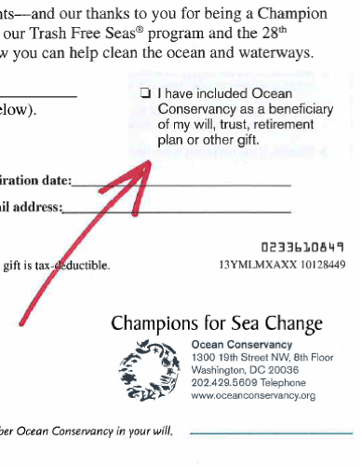
Notes:
MEG:

Slide 7
Notes:
MEG Here are a few examples of GP ads in AARP The Magazine and the AARP Bulletin which goes out to 38 million members. It’s also important to vary your message and images to attract different segments.

Slide 8
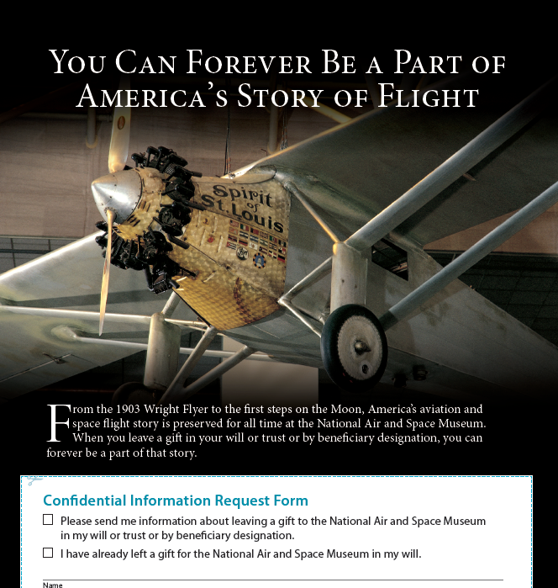

Slide 9
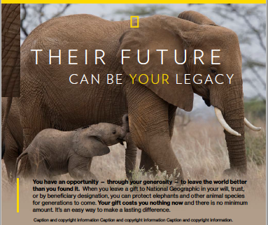

Slide 10
2. USE Acknowledgement buckslips
Free is good!
Piggy back on the acknowledgements you are already sending out
Great timing: your donor’s feel the most connected to your mission right after they have just given
Notes:
KATHY
Another very low cost way to get your message in front of people is through low cost inserts in your acknowledgments. Postage is already paid, the mailing is already going out so your only expense is to print the buckslip and the cost to insert it in the package. Another reason that this is such a great thing is that it comes at a great time – your donor has just donated to you and is felling good about you right after they’ve just given. So it’s a good time to present the idea to think about a larger investment.

Slide 11

Notes:
KATHY
For all those reasons, this is often our very first first recommendation for programs that are just getting started and don’t have a lot of budget to work with. Here’s an example for the League of Conservation Voters. When they didn’t have a lot of budget, we developed this insert that talks about environmental legacy – and included some of the key benefits. It’s easy. Costs you nothing now. Can provide for loved ones and the causes you care about. Back side has the sample language – so that even if someone never lets you know, they can include you.
With no stand alone marketing yet, this piece has resulted in an increase in the number of inquiries they have had in the past year

Slide 12
Notes:
KATHY
One thing to remember when using buckslips is to design a system to track who is responding to them. Some of the to consider are a special toll-free number only printed on buckslips, making the buckslip a reply device that can be mailed back, and printing a special code on the buckslip and asking each caller for that code.

Slide 13
3. USE Surveys
Let your donors feel heard/talk back
Engaging them in the cause reminds them of their passion
Planned Giving question becomes less threatening as part of an overall engagement technique
Surveys tap into their autobiography
Notes:
MEG: Surveys have become my top marketing piece for a few reasons. People like to be asked for their opinion, especially if asked by a cause they feel strongly about. This gives them a chance to engage with the charity they support and feel like they are being heard. On the flip side, for the charity, these surveys are a treasure trove of great information.

Slide 14
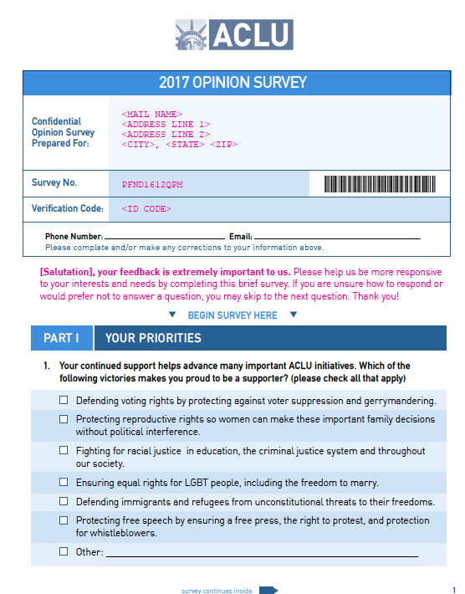
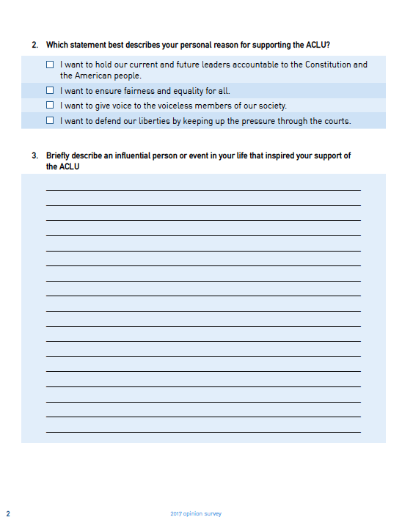

Slide 15
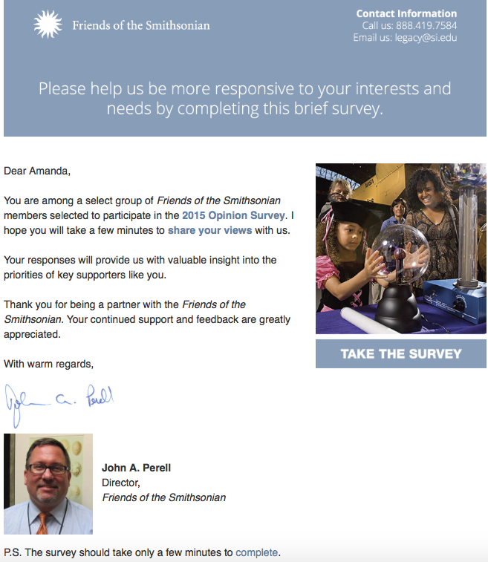
Notes:
MEG
Many organizations are having great success with digital surveys as well. We strongly encourage clients to run integrated programs where the print survey and the digital survey are both being deployed in the same time frame. We’ve seen response rates nearly double with donors who receive both, over those who receive only one.
Plus you can reach a much wider audience when you don’t have to pay for printing and postage
Here’s an example of the email (Personalized with the donor’s name) that we developed for the Smithsonian in partnership with Marketsmart.

Slide 16
…Survey Results
 | # Sent | New Gift | Intend | Consider | No or Blank | # of Responses | Response Rate | Qualified Response Rate
Total | 31,410 | 72 | 142 | 737 | 1,333 | 2,225 | 7.1% | 3.0%
879 Qualified Leads!
Notes:
From ACLU prospecting survey
discuss intends leads vs. consider leads.

Slide 17
4. Personalize COMMUNICATION
These are potential major donors – treat them as such
Planned Gifts are 15 to 30 times larger than a lifetime of annual giving
Personalization increases responses rates
In this day and age, there is no excuse for not personalizing your marketing
Notes:
KATHY
Personalization is something we’ve talked about, and utilized for many years in direct marketing. But until recently, it was still somewhat costly to do. Now, with the advent of digital printing, it’s incredibly easy and there’s no more excuse to NOT do it.
These are potential major donors – with gifts 15 to 30 times higher than a lifetime of annual giving . . . So it’s worth taking the extra effort.

Slide 18
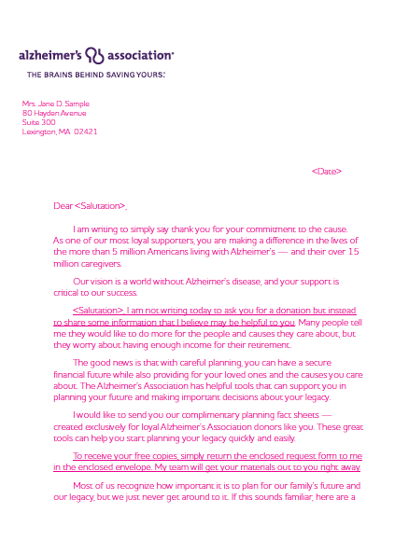
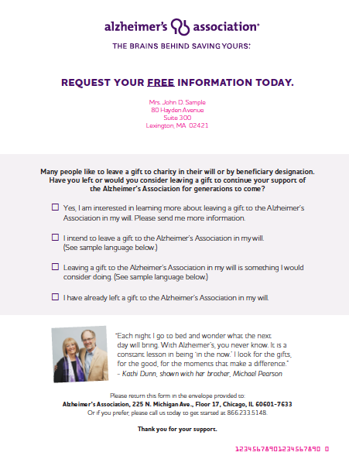
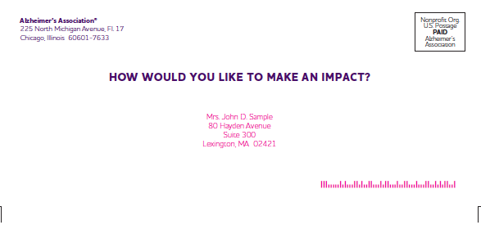
Notes:
KATHY
Here’s an example of a letter we did for ALZ. As you can see, the full name and address are on the letter. No “Dear Friend”
The whole thing has a very personal feel –when I see this, I think this is a letter sent directly to me – it’s for me.
If your budget is small, it can be tough trying to afford a package that has this higher touch. But we encourage you not to skimp. In most cases, if you do better targeting you can mail a better package that is higher touch to fewer people and generate the same number of leads – and probably better qualified leads.

Slide 19
5. Segment and Version
Show them you know them
Acknowledge your legacy society members in every mailing
Segmentation allows for better analysis of results
Notes:
MEG: The fifth tip is segmenting and versioning. I never send the exact same package to everyone on the mailing list for a specific appeal. If the recipient of the mailing is a Foundation donor, or a long-term member, or a member of one of our giving circles, I want the package he receives to recognize that person’s special connection to us. We have been getting better about segmenting and versioning with a lot of practice and analysis. I think one of our best efforts at this is reflected in our Spring 2017 CGA appeal which we partnered with Impact Communications to create.

Slide 20
You see, you already have something in common with Tom…he’s a Legacy Society member like you.
…he’s a dedicated supporter of AARP Foundation…
Creating new charitable gift annuities is smart…
Notes:
MEG: We created 3 different versions of this mailing. One for AARP Foundation donors who were possible suspects and prospects already in our pipeline. One for Legacy Society members with bequest gifts. And one for LS members who have other CGAs with AARP Foundation. This allowed us to explain the nuts and bolts of a CGA gift to those people who may not be familiar with it, while highlighting the benefit of multiple CGAs to those donors who already funded a CGA with us.

Slide 21
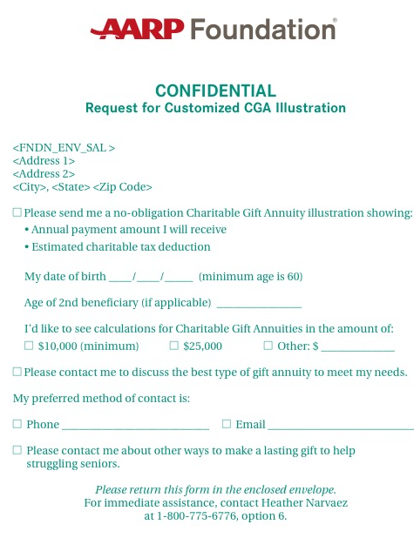
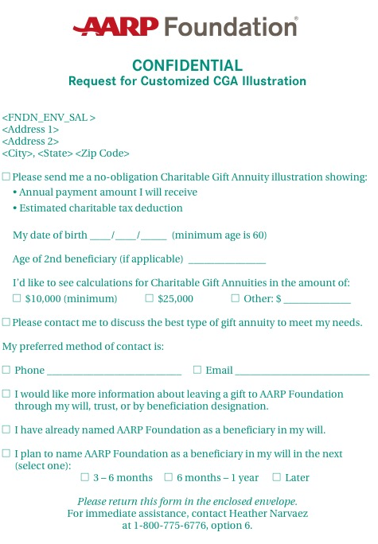
Notes:
MEG: But segmentation doesn’t stop with the cover letter. We also created different reply devices. We never pass up an opportunity to get our bequest messaging in front of our suspects and prospects. So while the LS bequest audience received a reply device that focused solely on a call to action for CGAs, the reply device for the suspect and LS CGA group also contained a call to action about bequest giving.

Slide 22
Segments / Description | Mail Qty | # Qual. Leads | New LOH Society | Intends | Might Consider | Would Not Consider | Non-Disclosure | Known Beq. Potential | Unknown Beq. Potential | Conversion of Might Consider | Total Beq. Potential
A - Legacy Society | 387 | 0 | 0 | 0 | 0 | 0 | 0 | $- | $- |  | $-
B - Intends | 417 | 7 | 2 | 3 | 2 | 0 | 0 | $168,000 | $98,280 | $56,700 | $322,980
C - Clinical Connection | 1,403 | 4 | 0 | 0 | 4 | 0 | 0 | $- | $- | $45,360 | $45,360
D - Prior tour/luncheon attendees | 96 | 1 | 0 | 0 | 1 | 0 | 0 | $- | $- | $11,340 | $11,340
E - Best of Best Loyalty Insights 24 mos | 3,505 | 10 | 2 | 0 | 8 | 0 | 0 | $80,000 | $98,280 | $90,720 | $269,000
F - Habitually Generous Loyalty Insights 24 mos | 3,619 | 4 | 1 | 0 | 3 | 0 | 0 | $84,000 | $49,140 | $34,020 | $167,160
G - Truly Connected Loyalty Insights 24 mos | 3,832 | 5 | 1 | 0 | 4 | 0 | 0 | $84,000 | $75,601 | $45,360 | $204,961
H - Bequest Likelihood score of 601+ 24 mos | 2,742 | 7 | 1 | 0 | 6 | 0 | 0 | $84,000 | $49,140 | $68,040 | $201,180
I - Donors 65+, 10+ years of giving, 24 mos | 3,583 | 5 | 0 | 0 | 5 | 0 | 0 | $- | $- | $56,700 | $56,700
Total | 19,584 | 43 | 7 | 3 | 33 | 0 | 0 | $500,000 | $370,441 | $408,240 | $1,278,681
Notes:
KATHY
This is a sample segmentation for a large hospital client we work with. Yours might be much simpler, many of our clients have just three segments. But this is to give you an idea of some of the ways you can segment the file to provide more targeted messaging – this client includes segments for Legacy Society, people who say they intend to leave a gift, prior pg event attendees and then several segments for the segments identified using Loyalty Insights screening.
Segmenting also allows you analyze your results to determine which segments are performing well. So that you can make better targeting decisions in your next mailing.

Slide 23
6. KEEP language SIMPLE
Marketing is not the time to have a technical conversation with your prospects
Use familiar language – often referred to as “family” language by Dr. Russell James
Words like “legacy” and “will” are easier to understand than “death” and “bequest”
Leave a gift vs. Make a charitable donation
Notes:
MEG: How intimidated do you feel when a professional starts using jargon you are not familiar with? We all just went through the process of filing our tax returns (I hope). Now, as Gift Planning professionals, we have some basic of understanding of taxes. But when your tax preparer starts talking in their language, don’t your eyes start the glaze over? I suspect most of us do not ask our preparer to keep going – tell me more!! Well, we need to keep that in mind when discussing bequests, and remaindermen, and residual interests with our prospective donors.
We are all familiar with Russell James and his suggested vocabulary when talking to our donors and prospects. Use words like legacy instead of estate plan. Gift instead bequest or charitable remainder unitrust.

Slide 24
Notes:
MEG: Here is a great example from The Nature Conservancy. The language is upbeat and positive. “Income for life” not “payments until you die”. Beautiful photos. Simple language. Lots of white space. Flowcharts for visual learners.
The point of marketing is to get your message read by the audience who is most receptive to it. When they ask for more information or tell you they are interested in a specific type of gift, you can then get into the details. But your marketing pieces should be as simple and reader friendly as possible.

Slide 25
Notes:
MEG: Here is an example of a Beneficiary Designation marketing piece from The Nature Conservancy.
Non jargon language on this factsheet:
-Sign your name
-gift costs you nothing now
-be remembered
-leave a gift
-how it works
-follow these steps
-ensure your wishes
-here to help

Slide 26
7. ReactivatE leads
How can you “reenergize” lapsed prospects? What’s wrong with donors who raise their hand but then never respond to your emails or calls?
Some donors will only ever want a relationship with you in the mail (i.e. they may never want to have coffee with you!)
Notes:
KATHY-This is an idea that is born of direct marketing. Your direct mail folks regularly work to try and reinstate lapsed donors. But in planned giving, once we generate a lead, if they don’t respond to our personal outreach . . . They often fall back into a more general pool . They may get the newsletter or an occasional mailing. But we rarely appeal to them directly. Truth is, PG leads that you’re generating from your direct mail file . . . many don’t want to talk to you. Their entire relationship with the organization has been through the mail and they are fine with that. So that means we have to go back to them with targeted messaging in the mail, a term Phyllis Freedman coined, “Moves Management in the Mail”

Slide 27
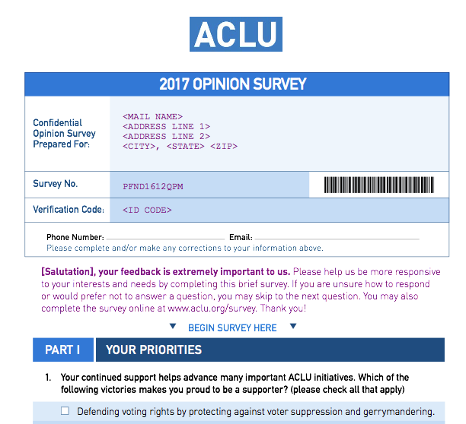
Notes:
KATHY
When donors raise their hand – but don’t respond to your calls or emails, what gives?
How do you reenergize “lapsed” prospects?
Keep them in the mail
Some donors will never want to have coffee with you!
This ACLU Survey was sent to anyone who previously raised their hands, but didn’t respond to personal cultivation
Qty mailed: 6416
TOTAL RESPONSES: 496
TOTAL RESPONSE RATE: 7.7
INTENDS: 38
CONSIDER: 282
ALREADY LEFT A GIFT: 44
**We mailed 6,416 people and had a response rate of 7.7% -- and from those responses, 320 qualified leads—people who say they people say they “intend” or will consider a gift and 44 disclosures and new legacy members.

Slide 28
8. cultivate YOUR PROSPECTS
    When developing your marketing efforts, you should not be just asking donors to leave a gift - you can also steward your planned giving prospects in the mail
    Give donors who have said “yes” access and opportunities to engage, which will enhance their relationship with your organization
    Newsletters are a great way to keep your prospects engaged in your mission!
Notes:
KATHY
When developing your marketing efforts it should include a mix of “solicitations” or lead generation pieces and cultivation or stewardship
For donors who have already let you know they’ve left a gift, you want to give them lots of information about your accomplishments to reinforce their good decision and you also want to provide opportunities for them to engage with you.

Slide 29
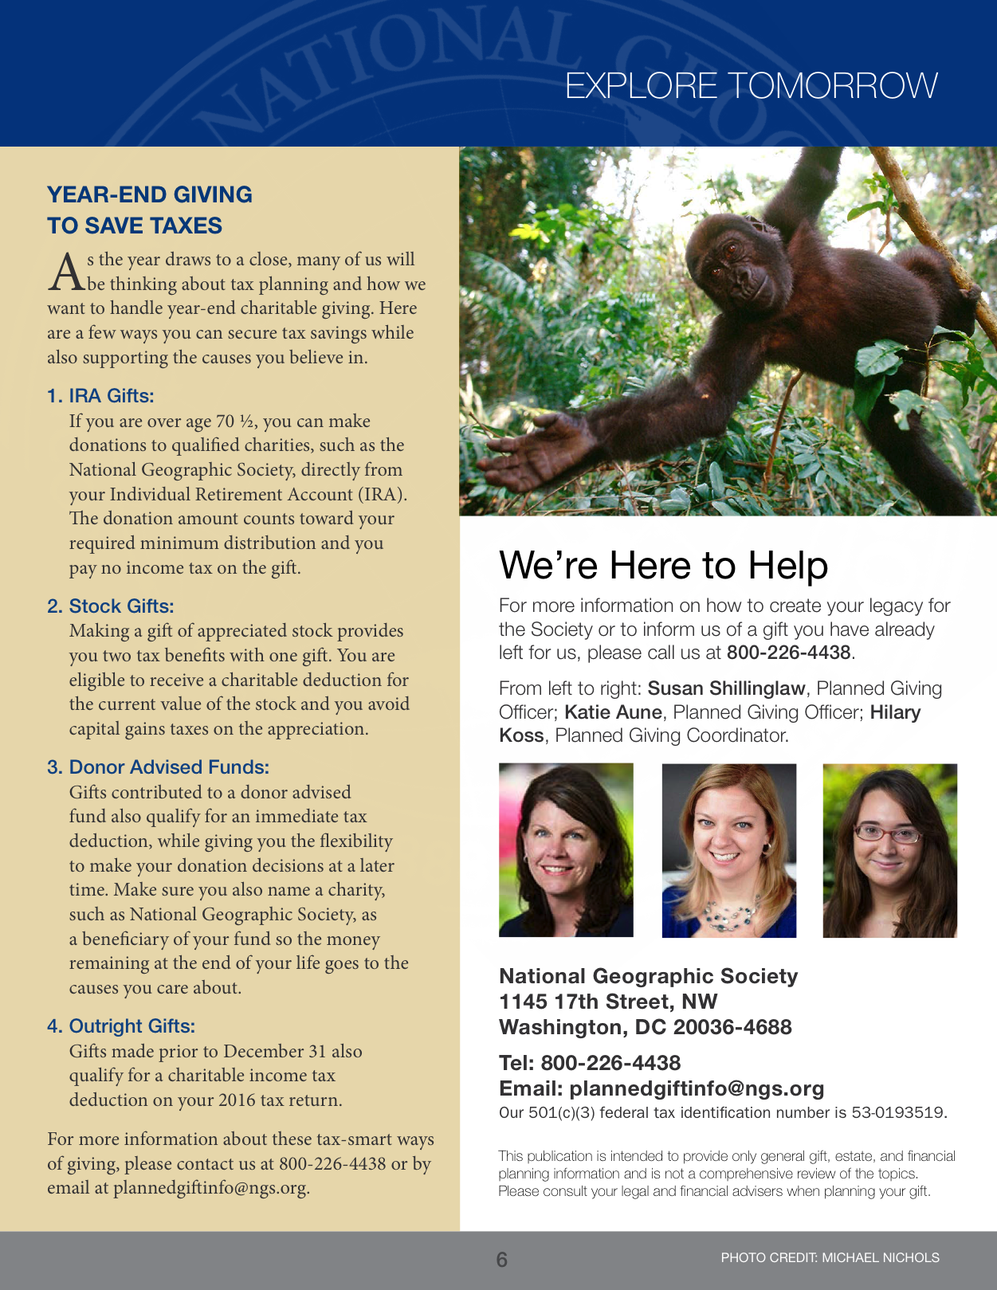
Notes:
KATHY
Here’s an example from National Geographic Society – the best part about working with them is the photos!! The newsletter leads with a donor profile and as you can see in the headline, we are really emphasizing the donor’s impact. And using donor profiles helps other donors wee themselves and creates “social norms”.
Always remember that the newsletter content should be about the donors, for the donors – and NOT about your planned giving program.
Note that we show photos of the planned giving officers – make them real and human which increases their success in reaching out
The headline of this first article emphasis the donor’s impact – it is also a donor showing how newsletters should put your donors front and center – about the donors, for the donors

Slide 30
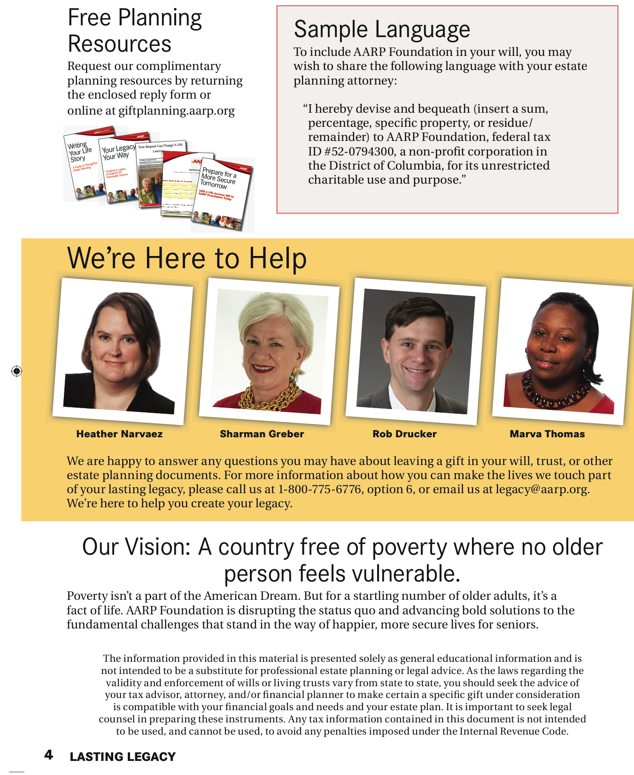
Notes:
KATHY: You should always include photos of the GP team or whoever will be doing the follow up. This has been very popular with the prospects and donors of many of our clients. Some do a lot of work over the phone, and they often hear comments such as “Now I can put a name with a face”, “I feel like I know you now”, and “I thought you’d be older”.
Some clients ask “What do you do when you have staff turnover”. I would suggest just having photos and names listed, not regions or specialties. Also remember that as officers of our organizations, while we are building relationships with these folks, the goal is to have them engage with the organization – grow close to the organization – not you as their relationship manager.

Slide 31
9. LEARN ABOUT Marketing automation
    Maximize your time in front of your donors – use tools that can automate your fulfillment response
    Landing pages, such as publications pages, allow your donors to automatically download your materials, saving you time!
    Tracking systems canalert you when donors have visited your website and might be ready for a contact
Notes:
KATHY
Marketing Automation – if you’re not using it yet, you will be soon. So what does it mean? Tools exist now and more are coming that allow you to program marketing pieces to be delivered to your donors based on their actions. We’ve all experienced this – fill out an online form for a loan, and get 5 emails back from companies who want to give you a loan. Look at something on Amazon – and they send you an email a couple days later asking if you are still interested.
You can use these tools in your marketing as well. You can automate fulfillment processing with an outsourced mail shop or use digital communications to send automatic emails with downloads to fact sheets. reduce time spent sending out packages, so you have more time to spend with donors.
One of our partners we work with, Marketsmart has a great platform that tracks your donor’s actions on their website, sends drip communication sautomatically, triggered communications when donors take certain actions and automatically lets you know when they’ve been very active on the site so you can follow up directly.

Slide 32
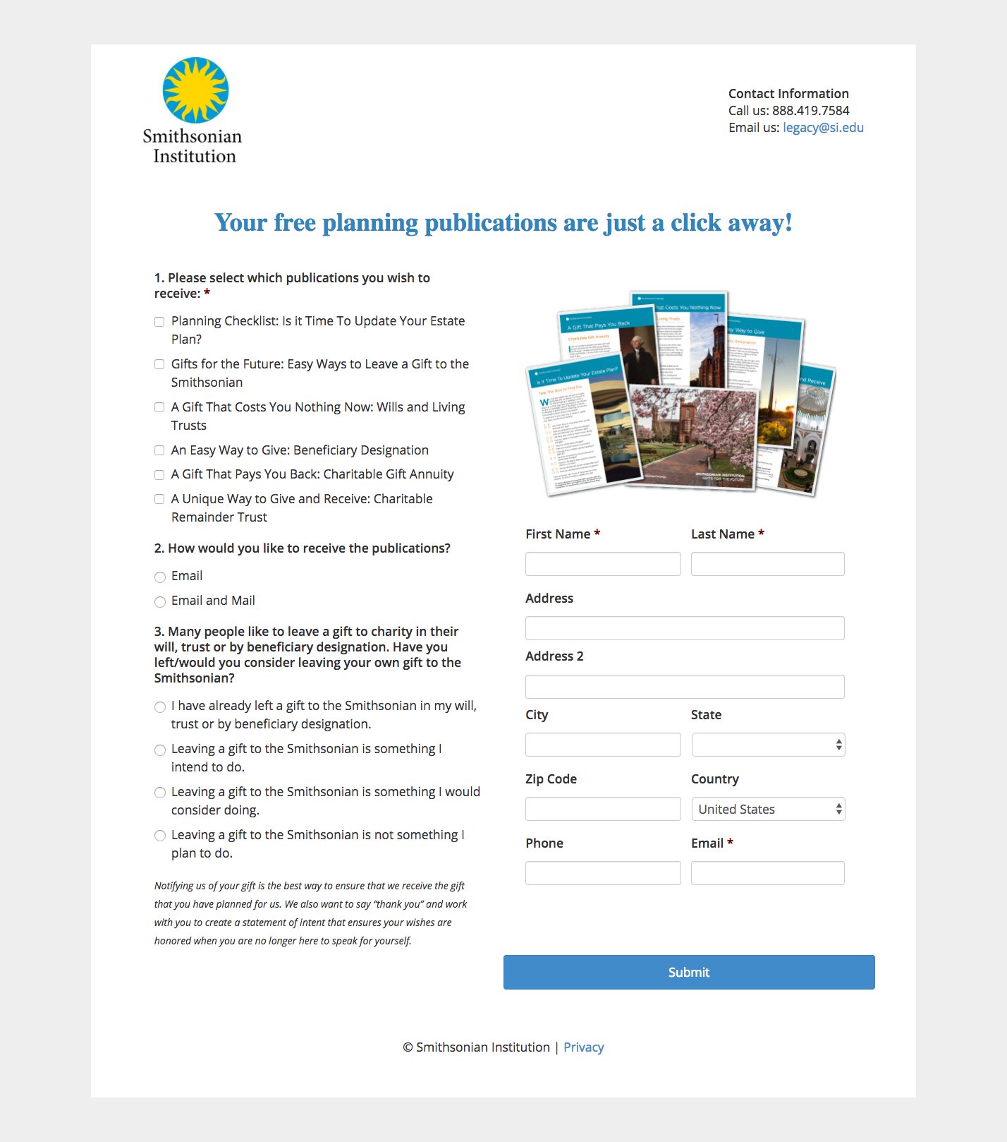
Notes:
KATHY
Here’s an example of a publications landing page created by Marketsmart for the Smithsonian. Shows images of the publications that are available – allows them to download them and then they will be automatically emailed and soon as this form is submitted.

Slide 33
10. PRE-PLAN fulfillment
    Good marketing can be destroyed by bad follow-up
    You must be prepared with staffing and materials to respond to leads that will be generated by your marketing efforts
    Factsheets are a great follow-up tool because they are easy to mail and can also be attached to an email or are easily downloaded by the donor
    If fulfillment becomes time-consuming for staff: outsource
Notes:
MEG
We included this slide because it is SO essential. I’ve had PG staff tell me they know marketing is happening but they never get the leads. Or they go so many leads that they didn’t get the follow up mail out for months. That’s why you must think of fulfillment holistically as PART of the marketing process – and make sure that all your systems are in place before any campaign is done.
What materials will you send to follow up, do you have cover letters written and customized based on their responses and/or audience segment?
Do you have the time to manage those mailings yourself, or do you need to outsource? If you outsource you must provide detailed instruction in writing and your consultants can help you – review live samples from the vendor – quality control
One tip for you to take away – kill the brochure. If you have limited budget dollars, don’t create big, expensive brochures. In direct mail, brochures are proven to suppress response because a person is likely to “put it aside” to read later. That’s not what we want.
We encourage you to develop simple, one page fact sheets.

Slide 34
Notes:
MEG
Fact sheets are easy and inexpensive to produce and mail. They can also be attached to an email or are easily downloaded from a website and look nice when printed out.
When we worked with SI, we worked with their DM fulfillment company so that these would be sent automatically and they would get out the bulk of follow-up

Slide 35

See, MARKETING IS NOT A DIRTY WORD…

Slide 36
Questions?
Kathy & Meg love talking shop or about
Hamilton, the musical.
Contact them at:
kswayze@impactdc.com
or
mroberts@impactdc.com
202-543-7671

Slide 37
Thank you!

