Slide 2

Liz FitzGerald
Director, Special Gifts
ACLU Foundation
Mohammad Zaidi
Director of Gift Planning
ACLU Foundation
Meg Roberts, CFRE
Vice President, Gift Planning
Impact Communications
Notes:
introductions

Slide 3
Learning Objectives
Solutions for common inter-departmental challenges
Suggestions for appropriate division of labor to maximize efficiency and consolidate messaging
Success stories of how inter-departmental partnerships can raise more money, decrease expenses, and increase donor loyalty
Notes:
MEG

Slide 4
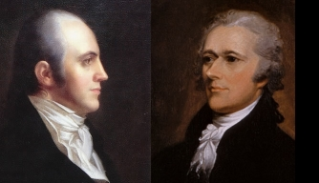
Planned Giving vs. Direct Response
Notes:
MEG
List ways each department approaches fundraising differently– ASK THE AUDIENCE
PG: 1:1, DR Many: 1
PG: not good marketers, better relationship builders
DR: More focused on cost per package than on building long term relationship
PG:Taking the long view
DR: urgency in everything
Don’t miss you shot—Build a bridge between the two departments

Slide 5



What Kind of ‘Shot’ are We Talking About?
Notes:
MEG
Let’s get specific…
Often, PG is aligned with MG, but best prospects often come out of DR file
Want to make sure you’re working collaboratively together
You’re leaving money on the table if you don’t work collaboratively--- that’s the “shot” we’re speaking about
If you don’t work together, one of you ends up dead. Constantly one-upping each other was their downfall.
MZ – We can’t emphasize enough how interdependent PG and DR are. The PG program rises and falls on gifts from people who were never major donors.

Slide 6
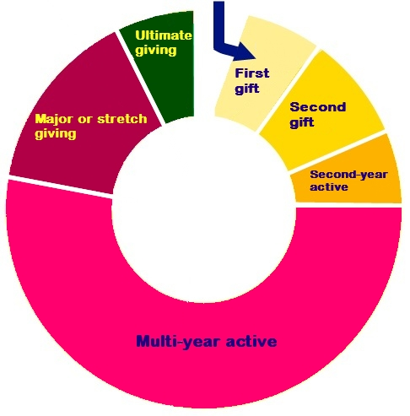
What Kind of ‘Shot’ are We Talking About?
Notes:
MEG
We’re talking the lifespan of a donor

Slide 7
Death Doesn’t Discriminate
An estimated 59 TRILLION DOLLARS will be transferred from American estates by the year 2061
Bequests made up 8% of total giving in 2016
The baby boomer population has decreased by 4M since 1999.
Notes:
MEG
Whether you are a nonprofit or an agency, this should peak your interest. $59 Trillion.
Other organizations are recognizing the potential and investing more now in gift planning marketing and stewardship now.
The good news is, that if you are a direct response fundraiser, you can get in on this. It’s not just good news for the gift planning team.
Mohammad and Liz will talk a little bit later about what a great time the ACLU Foundation is having integrating their marketing efforts. And they’ll share how improved collaboration between direct response and planned giving has lifted all boats.
Improved donor retention
Upgraded levels of giving, and
Recognition that majority of dollars raised in planned giving are coming from donors that you recruited, stewarded and retained for many years.

Slide 8

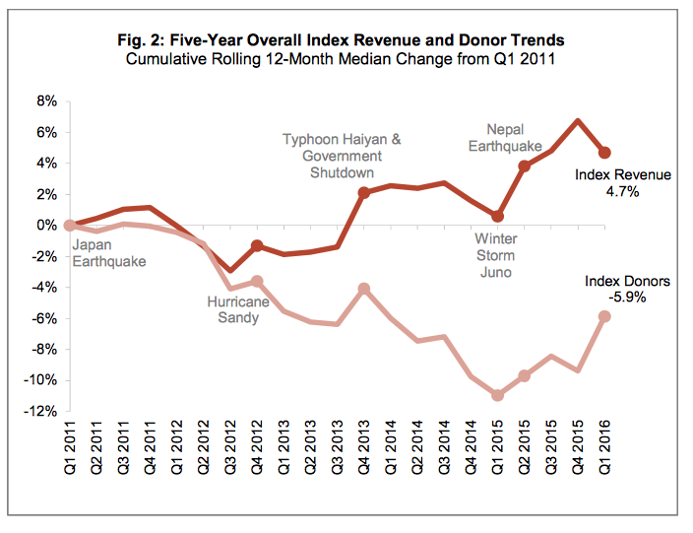
Direct Mail Response Decreasing
Source: Target Analytics
Notes:
LIZ?
Where are we now ? Chart
This is a picture you are familiar with. We’re all coping with a downward trend in direct mail revenues and donors – as shown in this graph from Target Analytics.
You can see that even though total revenue is up about 11% over the past 10 years, donor acquisition and retention is down 11%.
Planned giving is an antidote to this downward trend.
Note ACLU is an anomaly in this category

Slide 9
Bequest Projections Increasing

Slide 10
Bequests: King-Size Gifts
Lifetime Giving Total:
$25 Annually for 30 Years
Source: Donor Centered Planned Gift Marketing, Michael Rosen
Notes:
MEG
Another reason you should care is that there is a lot of money at stake– gifts that can be truly transformational for your mission. A bequest is worth far more to your organization than an annual gift. If your average annual gift is $25 and a loyal donor gives for 30 years, their giving still doesn’t come close to an average sized bequest.

Slide 11
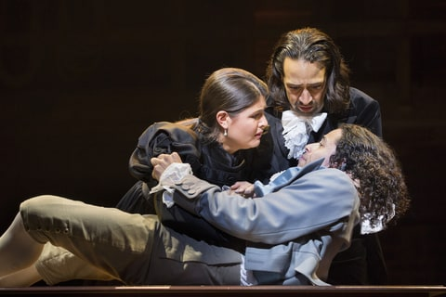
Don’t Panic! Remember…
Notes:
MEG
Don’t panic! We’re here to learn how to work together… BETTER!

Slide 12

A Rising Tide Lifts All Boats
Notes:
MEG

Slide 13
Improving the DM bottom line
Giving Before & After Adding a Charitable Gift to Estate Plan
Average Annual Giving Before Plan: $4,210
Average Annual Giving After Plan: $7,381
Increase of $3,171 PER YEAR
Source: Russell James, PhD, Texas Tech University
Notes:
MEG
How can we pull up DM Bottom lines with PG?
Increase in annual giving after bequest- chart
WHY is this?
MZ
Our internal example is an analysis of $1,000+ annual donors who made annuities. Average annual giving increased from $5,300 to $5,600. And the average annuity was nearly $100,000.

Slide 14
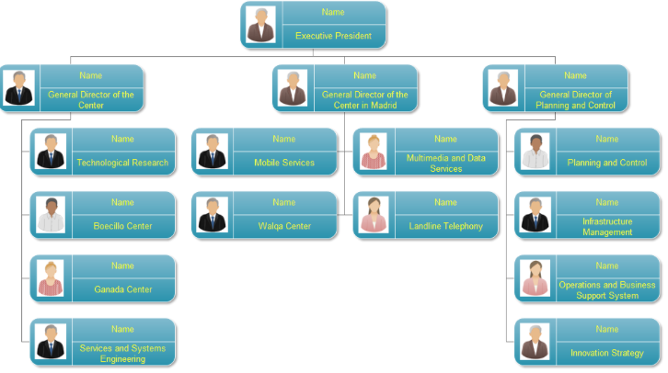
Internal View of Your Organization
Notes:
MEG
Lessons on Collaboration
We draw a bright line between the annual fund and gift planning, but our donors don’t. To them, it’s all the same organization.

Slide 15

How Your Donors See You
Notes:
MEG
The donor wants to feel cohesiveness and continuity no matter what department it is coming from

Slide 16
SOLUTIONS
Notes:
MEG

Slide 17
PG Segmenting:
Stewardship
Qualified Leads
Targeted Audience
Mass Audience
Notes:
LIZ and MZ start
Messaging is SO important:
Segment audience to speak with each differently
Legacy=stewardship
Qualified Lead=Moving prospect to the next step in consideration of a gift
Targeted Audience=getting them to raise their hands to ask for more information
Mass Audience=general messaging
Slide may move farther down… PG segmenting-= separate slides
Stewardship
Qualifited leads
Hand raisers– spring newsletter– difference in cover letters
Magazine ads– mass audience
Inside of the envelope

Slide 18
Format and Modify Standard Messaging
Talk to donors on a personal level
Take the “long view” when framing the issue at hand
Notes:
Many urgent needs while also showing rich history and playing the long game. Progressing through the decades
Insert sentences side by side to compare--- it’s easy to think in the moment, but

Slide 19
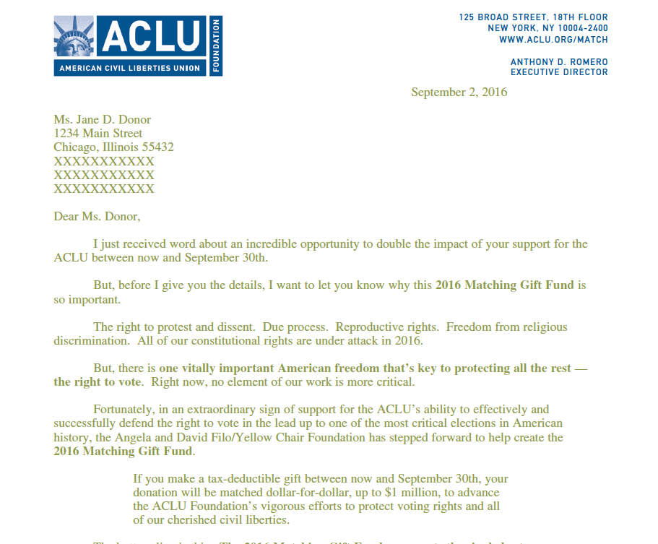
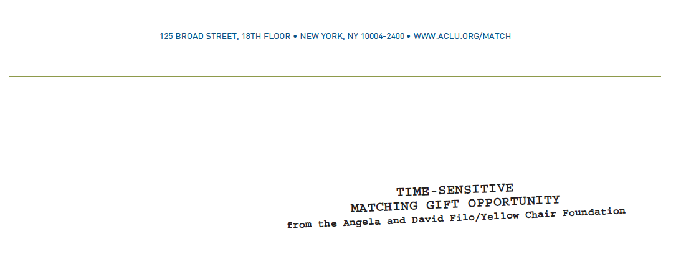

Notes:
mid-level donor appeal
INSERT PULL QUOTE
Insert Annual fund match vs. legacy match

Slide 20
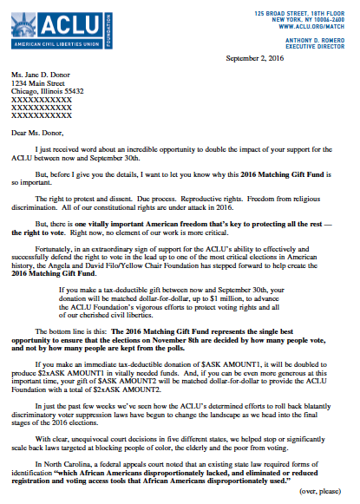
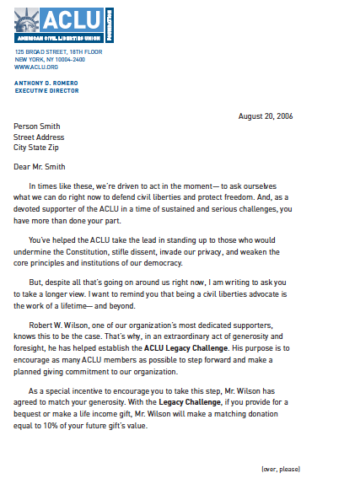
DR Match Language:
“The bottom line is this: The 2016 Matching Gift Fund represents the single best opportunity to ensure that the elections on November 8th are decided by how many people vote, and not by how many people are kept from the polls.”
Notes:
DR Match Language side-by-side
LIZ SENDING NEW MATCH LANGUAGE

Slide 21
PG Match Language:
“You’ve helped the ACLU take the lead in standing up to those who would undermine the Constitution, stifle dissent, invade our privacy, and weaken the core principles and institutions of our democracy.
But, despite all that’s going on around us right now, I am writing to ask you to take a longer view. I want to remind you that being a civil liberties advocate is the work of a lifetime– and beyond.”
Notes:
PG Match Language side-by-side
In times like these, we’re driven to act in the moment—to ask ourselves what we can do right now to defend civil liberties and protect freedom. And, as a devoted supporter of the ACLU in a time of sustained and serious challenges, you have more than done your part. You’ve helped the ACLU take the lead in standing up to those who would undermine the Constitution, stifle dissent, invade our privacy, and weaken the core principles and institutions of our democracy. But, despite all that’s going on around us right now, I am writing to ask you to take a longer view. I want to remind you that being a civil liberties advocate is the work of a lifetime—and beyond.

Slide 22
Urgent Appeal
“I know from the outpouring of activism we’ve seen in the past two months that people all across America are with us. Now, with the Trump presidency underway, you and I have to be ready to respond quickly and decisively…
To ensure that the ACLU can meet the awesome responsibilities of this moment, I am urging you to rush a generous donation of $AMT1, $AMT2 or more to our Constitution Defense Fund.”

Slide 23
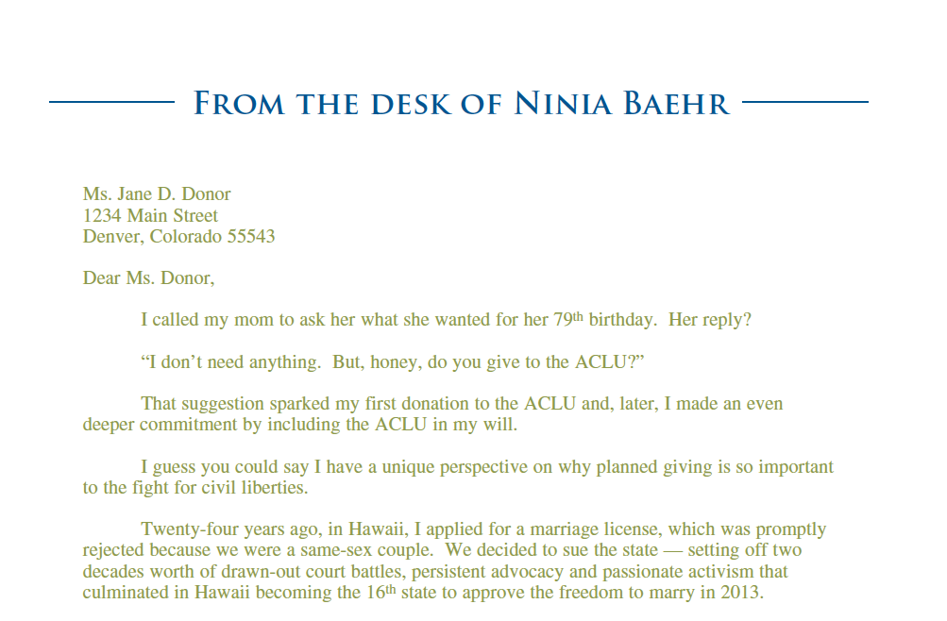
PG Appeal
“That unyielding persistence is sustained not only by current supporters of the ACLU like yourself, but also by people who — years or even decades ago — decided to include the ACLU in their wills…
ACLU members made planned gifts in the past without being able to predict exactly
when and where their commitment would have an impact. Yet now, those planned gifts are helping to propel the organization’s current work forward.”
Notes:
PG Appeal
INSERT PULL QUOTE
Throw in more examples of messaging and how it changes based on what segment

Slide 24
Challenges
Competition
No Current infrastructure in place
No Budget
No Time
Notes:
MEG– introduce red curtain ideas and then L & M discuss each topics
Challenges in Collaboration & What if you’re a small shop?? ASK THE AUDIENCE
MOHAMMAD
Competition
No current infrastructure in place
Budget
No time

Slide 25
Master Calendar
Establishing One
Making It Work
Now’s the Time to Look at Segmentation
Modeling
Notes:
LIZ How can we save time and money for DR and PG?
Insert image of ACLU’s master calendar
Place for segmentation– isolate groups that have grater value to PG– now is good time to hash out
Modeling
Talk about the process

Slide 26
Inter-Departmental Meetings
Keep each other up to date on messaging, calendar changes, and urgent issues
Keep in mind what’s best for your donor
Culture of evidence-based
Notes:
MOHAMMAD
Share how you keep each other up to date with messaging, calendar, pop-up urgent issues
Share that it’s an organic process
With some groups it will need to be more formalized
Share other ideas about what may work
Negotiations: we want to do what’s best for the donors, willingness to work together
Our culture here is that things are evidenced-based. People need to bring that to the table
Song: duel commandments

Slide 27
Common Goals
Keeping your donor at the center
Decide if sharing metrics will help
Understand each other’s goals
If you keep dueling, one of you is going to end up dead
Notes:
LIZ
Set up shared metrics, so you’re not working against your own program
ACLU has never had shared metrics
Ocean Conservancy example: DM team had responsibility to help close more gifts, identify more hand-raisers, vice-versa
They ended up all reporting to the same person after two years
Go back to donor experience and donor perspective!
M: less about metrics, more about meeting goals
L; cummulative effort, well developed development program will benefit at ALL levels
M: How do you create common sense? Force it by metrics or not? Maybe they will help understanding, maybe not
M: there is point where metrics become self-defeating

Slide 28
Production Efficiencies
Ask the experts
Batch printings
Share techniques
Notes:
L: don’t ask someone who does it once a year– get the folks who know how to do it and rely on their expertise
How do you share techique, design, get PG stuff opened

Slide 29
Be In The Room Where it Happens
Share copy with each other
Share expertise
Work from same talking points
Remember the donor’s perspective
Notes:
MOHAMMAD
Have DR team review– this carrier might work better, etcM gets copies of everything– it’s very help for him
Remember the donor perspective

Slide 30
Multi-Use Stewardship Pieces
<As a Visionary Council member,> < As a Legacy Society member,> < As a member of the Research Partners Network,> <You> are, quite simply, the backbone of our work. To show you exactly how your dollars are making a difference, I am pleased to share with you our Annual Report
<As a Visionary Council member,> < As a Legacy Society member,> < As a member of the Research Partners Network,> <You> are, quite simply, the backbone of our work. To show you exactly how your dollars are making a difference, I am pleased to share with you our Annual Report
Notes:
MOHAMMAD
If a stewardship piece is going out to mid-level, think if it’s worth sending it our to PG as well.
EXAMPLES IN SLIDE:
Annual report- different versioned cover letters

Slide 31
Next Steps
1. Set up a meeting to discuss common goals with your colleagues
2. Make room for all appeals in your marketing calendar by identifying key audiences
3. Identify stewardship pieces that can be customized for annual and planned giving donors
4. Personalize your appeals to show donors you know them
5. Create standard messaging that can be customized for both immediate and long-term gifts
Notes:
What can you do differently—starting on Monday! (key takeaways)
A few longer term goals to aim for
I would add (and it may be part of 1 or 2) identify key audiences that you want to reach out to for planned giving so that you can decide which will get priority

Slide 32

Questions?

Slide 33
Notes:
Insert slide to scale

